Slide 1


Air Force Institute of Technology
NENG 791 – Proliferation of Weapons of Mass Destruction
Special Nuclear Material Signatures
Lt Col Fee
E d u c a t i n g t h e W o r l d ’s B e s t M i l i t a r y
Notes:
In my opinion, understanding of this lecture and the passive / active detection topics is by far the most important material covered in this course.
Many of these slides were taken from (or are modifications of) a slide deck developed jointly by the Massachusetts Institute of Technology, The Pennsylvania State University, and Texas A&M University with funding provided by the NNSA through the Global Threat Reduction Initiative.
The purpose of this collaboration was to provide academic institutions with increased nuclear security-related education and training for integration in their nuclear science and engineering related programs.

Slide 2
An Overview of Background Radiation and Sources
Notes:
To start, we’ll take a few minutes to look at background radiation.
The purpose of this look at background radiation is to better inform you of how this background (and the many ways it can change) impacts your ability to detect SNM.

Slide 3
What is radiation background?
Radiation background can be broadly defined as the radiation present at the measurement location that is due to all radiation sources not associated with the radiation-producing activity of interest.
Sources of background:
cosmic (usually dominant)
terrestrial
man-made
The common and usually dominant source of background is that due to naturally occurring sources.
Can you name some reasons why and/or how background varies?
Notes:
Source: R.T. Kouzes, et al. Radiation Detection and Interdiction at Borders
Can you name some of the reasons why or how background varies?
Varies in energy (so we may need energy resolving detectors)
Varies spatially (so we may use imaging to increase the signal-to-noise ratio)
Varies in time (so we may account for the time of day or time of year)
Environmental factors (so maybe we consider… …many different things)
When the background varies too much what can we do to identify SNM?
…active interrogation

Slide 4
Just how difficult is detection of a Pu-weapon? Let’s look at the neutrons…
consider 10 kg of w.g. Pu, in the center of a 2-m tank truck of water
spontaneous neutron emission rate is 520,000 n/s
99.98% from ^{238,240,242}Pu impurities
but self-shielding (@1 MeV) is 1/1.3
and thermalization × absorption × Ω is 1/1x10⁸
so signal is 0.004 thermal n/cm²s
About 1/5 of cosmic-ray neutron rate
²³⁵U is 10⁶ times more difficult to detect!
Notes:
Previously I told you that detecting a Uranium-based weapon is potentially much more difficult than detecting a Pu-based weapon because of the signatures.
We also stated that Pu emits a lot of neutrons. Well, how do these neutrons compare to the background rate?
Weapon grade definition from Nuclear Threat Initiative (NTI.org). 0.01% 238, 93.8% 239, 5.8% 240, 0.13%241, 0.02%242, 0.22% Am-241. Calculation by Lindstrom at NIST using 2-group calculation from J. R. Lamarsh, Introduction to Nuclear Engineering, 2nd ed., Addison-Wesley, Reading, MA, 1983.
Note that cosmic ray induced neutrons are especially present with eg large steel structures (the “Ship Effect”)

Slide 5
Terrestrial background
Naturally occurring radioactive nuclides on earth and daughters occurring in their decay chains
Approximately 70 such natural radionuclides exist
Can be classified into primordial and cosmogenic
Primordial radionuclides
Present on earth since its formation; very long half-lives
Examples: ²³⁸U, ²³⁵U, ²³²Th, ⁸⁷Rb, and ⁴⁰K
Cosmogenic radionuclides
Continuously produced by cosmic rays, relatively short-lived
Concentration determined by the balance between the cosmic ray production and radioactive decay
example: ¹⁴C continuously produced in the ¹⁴N(n,p)¹⁴C reaction
Notes:
Ref. Eisenbud
Many more than 70 exist, but we are talking those with enough of an activity to be a n issue for detection.

Slide 6
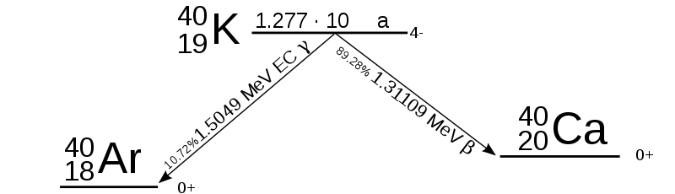
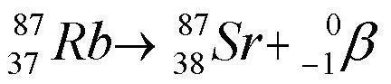
Low-Z radionuclides present in nature in significant quantities
Primordial ⁴⁰K and ⁸⁷Rb, and cosmogenic ¹⁴C
⁴⁰K has a natural abundance of 0.0117%, a half life of 1.248x10⁹ yrs, and it undergoes β⁻ decay, β⁺ decay, and electron capture
Most of the atmospheric ⁴⁰Ar (1% of atmosphere) originates from the ⁴⁰K decay
⁸⁷Rb has a half-life of 4.92×10¹⁰ years, decays by β⁻ decay into stable ⁸⁷Sr, and is readily substituted for potassium in minerals
Notes:
Reference: Shultis&Faw & Eisenbud

Slide 7
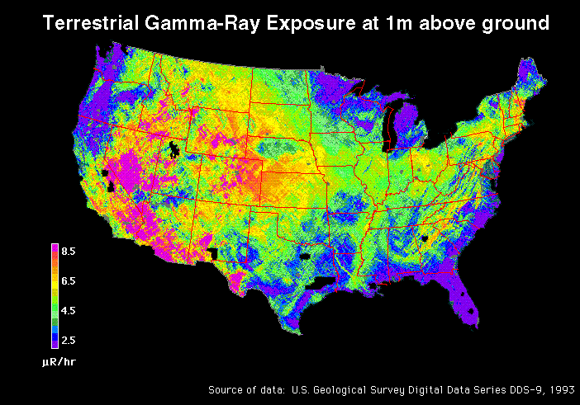
Terrestrial background main sources and distribution
uranium, thorium and their decay chains (²²²Rn, ²¹⁹Rn, ²²⁰Rn)
potassium ⁴⁰K
Notes:
USGS DDS-9
These images were generated from NURE aerial gamma-ray data presented in United States Geological Survey Digital Data Series DDS-9, "National Geophysical Data Grids: Gamma-Ray, Magnetic, and Topographic Data for the Conterminous United States", by J.D. Phillips, J.S. Duval, and R.A. Ambrosiak, 1993.

Slide 8
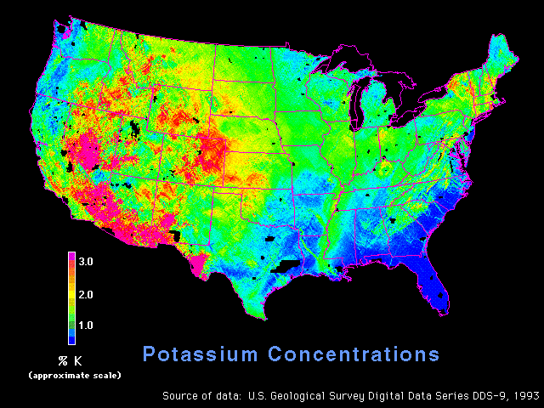
Potassium concentrations
Notes:
USGS DDS-9
These images were generated from NURE aerial gamma-ray data presented in United States Geological Survey Digital Data Series DDS-9, "National Geophysical Data Grids: Gamma-Ray, Magnetic, and Topographic Data for the Conterminous United States", by J.D. Phillips, J.S. Duval, and R.A. Ambrosiak, 1993.

Slide 9
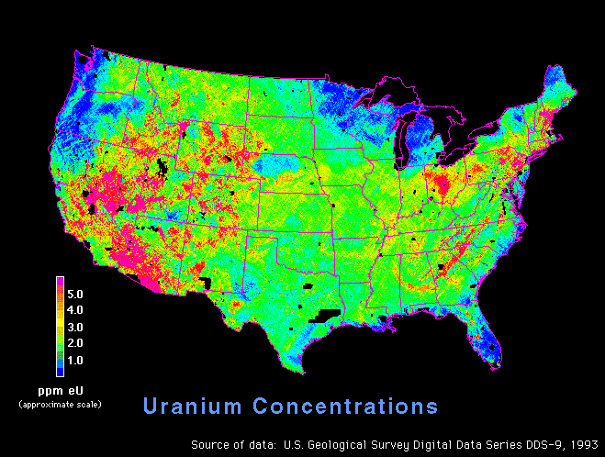
Uranium concentrations
Notes:
USGS DDS-9
These images were generated from NURE aerial gamma-ray data presented in United States Geological Survey Digital Data Series DDS-9, "National Geophysical Data Grids: Gamma-Ray, Magnetic, and Topographic Data for the Conterminous United States", by J.D. Phillips, J.S. Duval, and R.A. Ambrosiak, 1993.

Slide 10
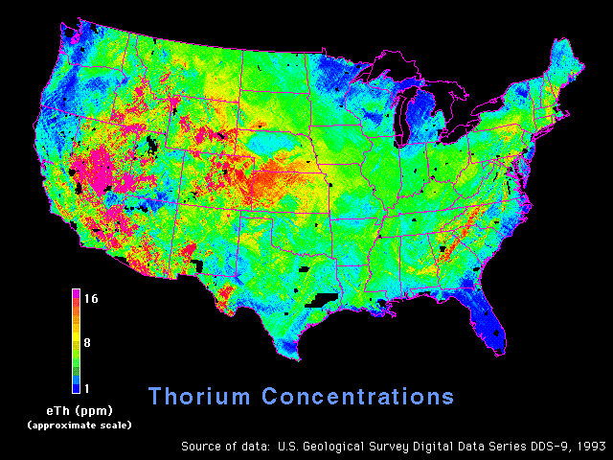
Thorium concentrations
Notes:
USGS DDS-9
These images were generated from NURE aerial gamma-ray data presented in United States Geological Survey Digital Data Series DDS-9, "National Geophysical Data Grids: Gamma-Ray, Magnetic, and Topographic Data for the Conterminous United States", by J.D. Phillips, J.S. Duval, and R.A. Ambrosiak, 1993.

Slide 11
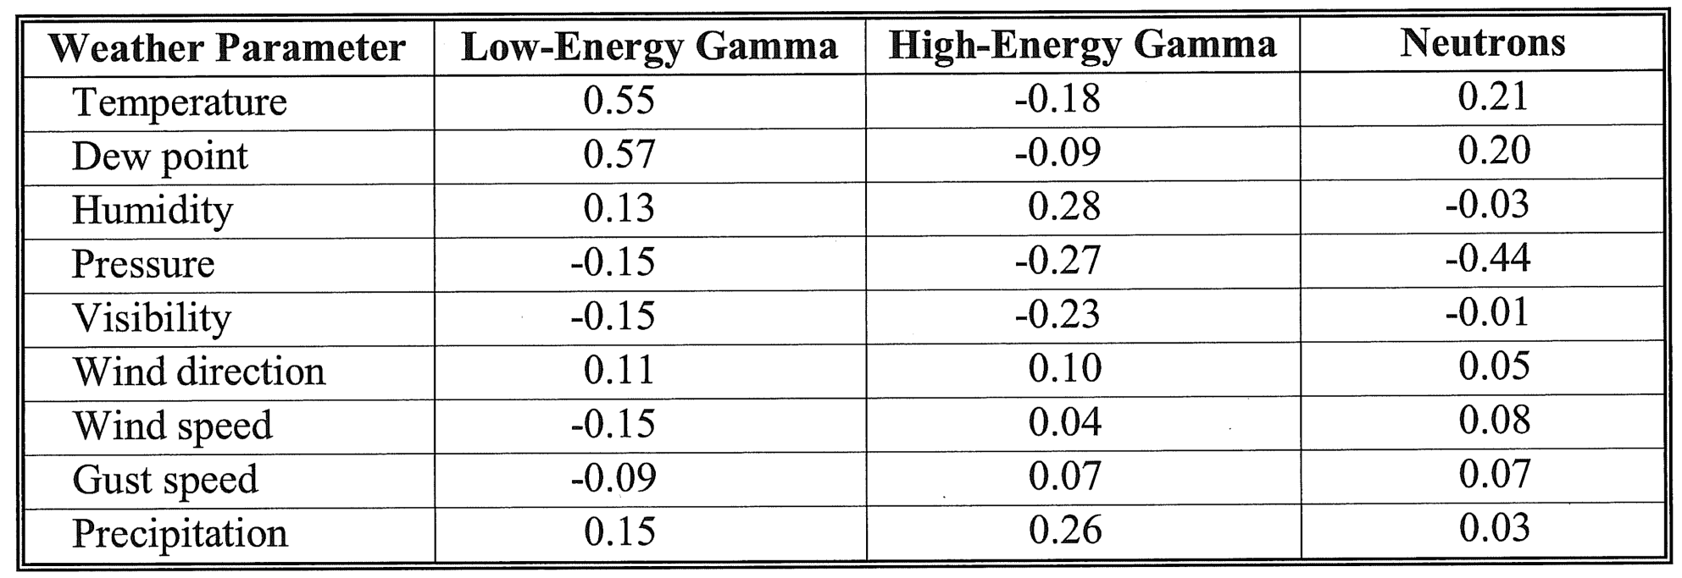
Weather-related variations in background: correlations with weather parameters
Data from radiation portal monitors
>0.45: strong correlation
0.3-0.45: good correlation
0.2-0.3: moderate correlation
0.1-0.2: weak correlation
<0.1: insignificant correlation
Notes:
Ref. Kouzes
The point of this slide is just to show you that environmental factors impact the background

Slide 12
Naturally occurring radioactive materials (NORM)
Typical commercial shipments that trigger “nuisance alarms”:
Agricultural products, glazed ceramics, camera lenses, polishing compounds and abrasives, propane tanks, kitty litter, road salt, ore, rock, vulcanized rubber, TV and computer monitors, medical isotopes, and smoke detectors
Isotopes present in NORM: uranium/thorium series and potassium
Technologically enhanced NORM (TENORM): also may contain ¹⁷⁶Lu
Notes:
Ref. Kouzes

Slide 13
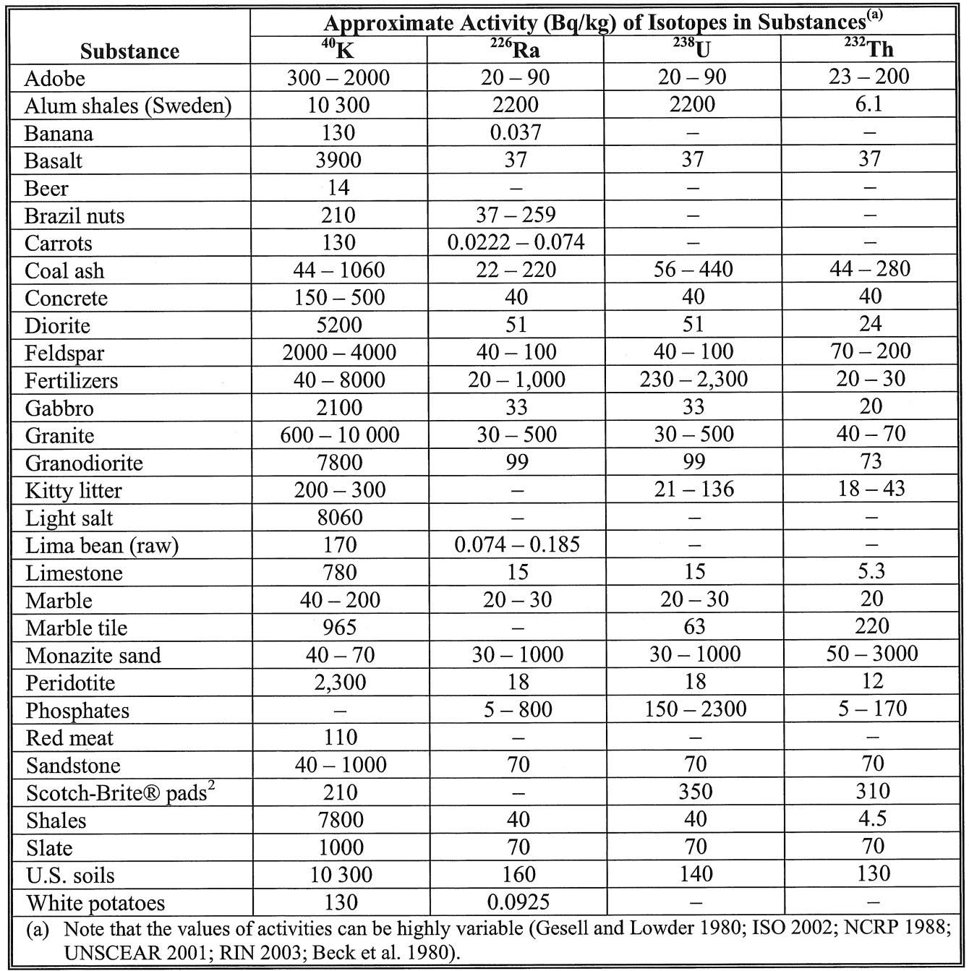
NORM activity
Notes:
Ref. Kouzes
If you look at this, you can see that many common materials have activity that will be picked up by our portal monitors

Slide 14
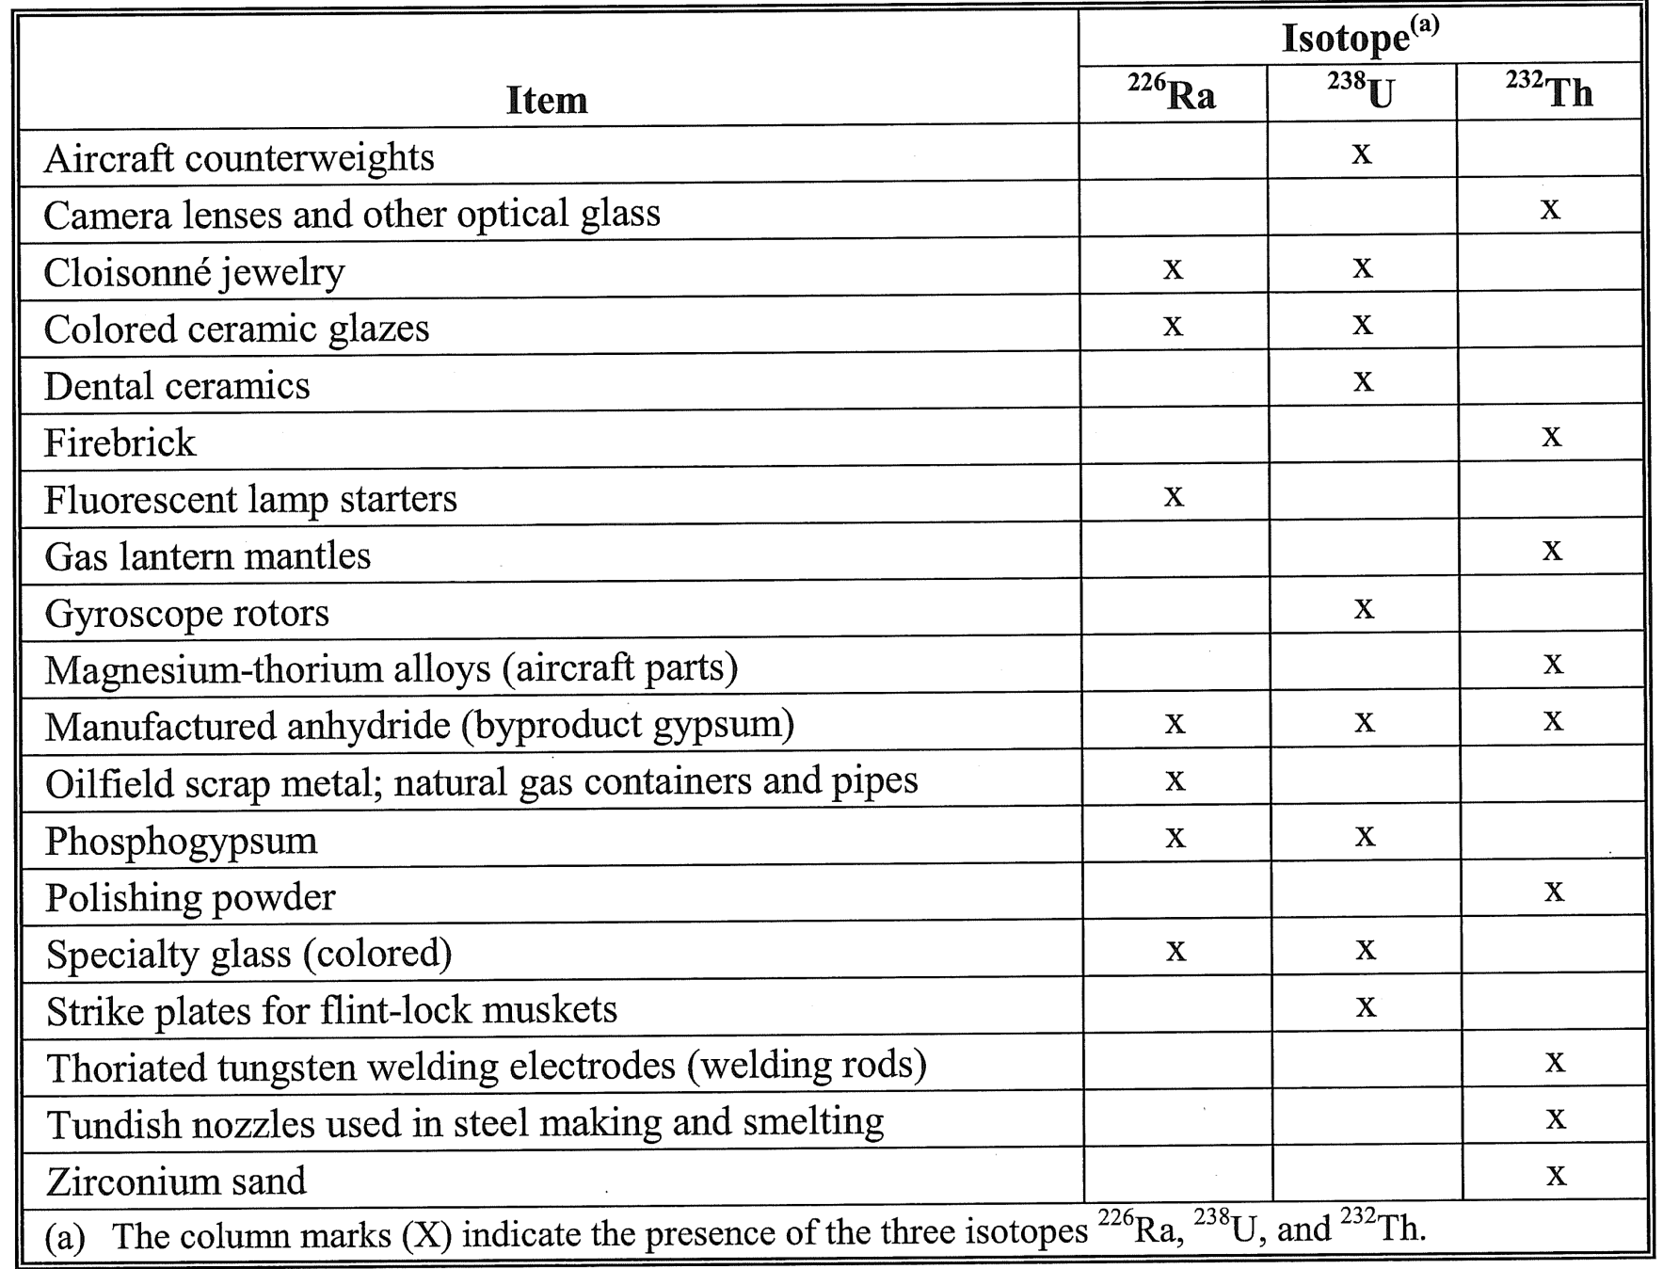
Other cargo known to contain NORM and TENORM
Notes:
Table 2-5 (Kouzes)

Slide 15
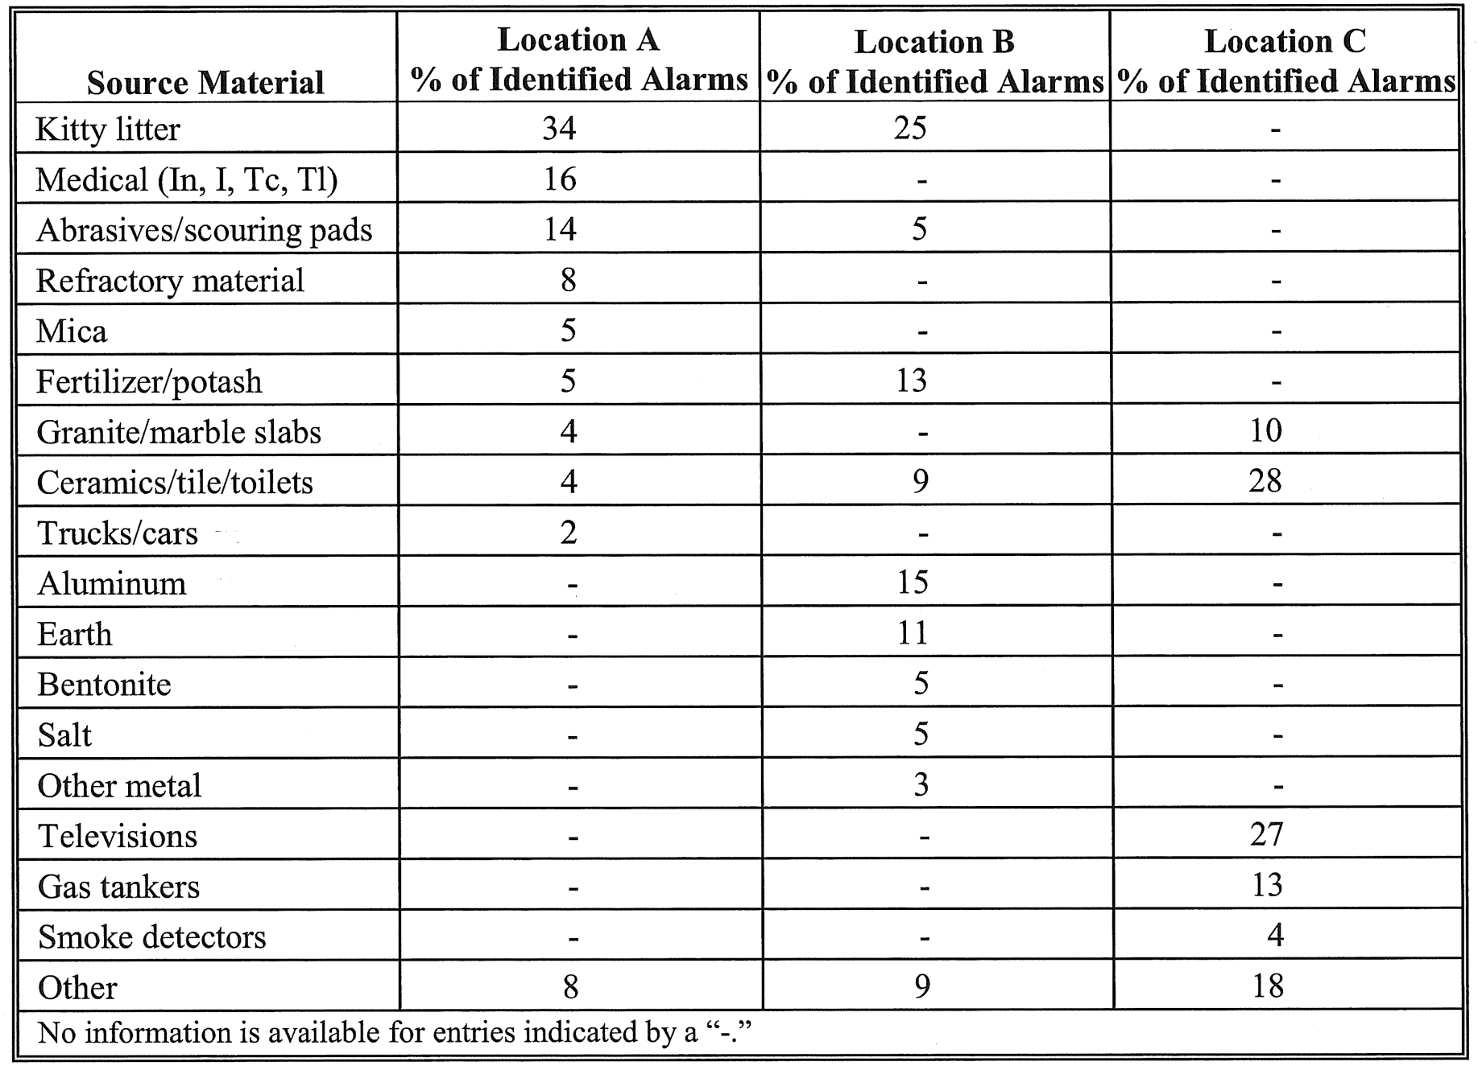
Approximate relative percentage of alarming cargo loads at some border crossings
Notes:
Table 2-6 (Kouzes)
This slide shows you the percentage of time that portal monitors went off because of the cargo and the type of cargo.

Slide 16
Construction Materials & Other Materials
Typical and maximum activity concentrations in common building materials and industrial by-products used for building materials in the EU
Notes:
“Radiological Protection Principles concerning the Natural Radioactivity of Building Materials” (Radiation protection 112), European Commission Directorate-General Environment, Nuclear Safety and Civil Protection, 1999.

Slide 17
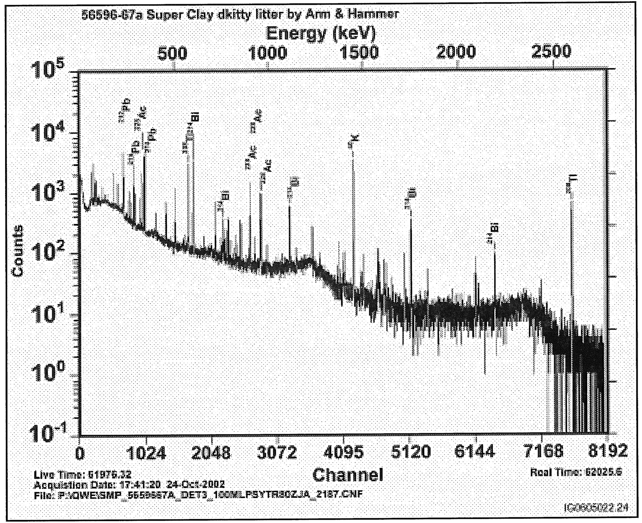
Photon spectra from kitty litter (uranium, thorium, potassium)
Notes:
Fig. 2-18 (Kouzes)

Slide 18
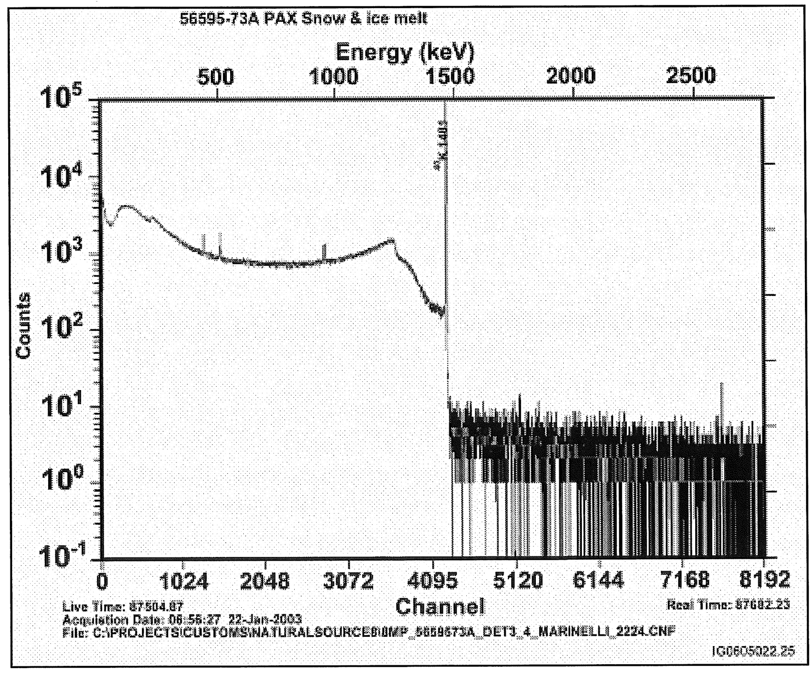
Photon spectra from road salt (potassium)
Notes:
Fig. 2-19 (Kouzes)
Spectrum of K-40, very common in labs

Slide 19
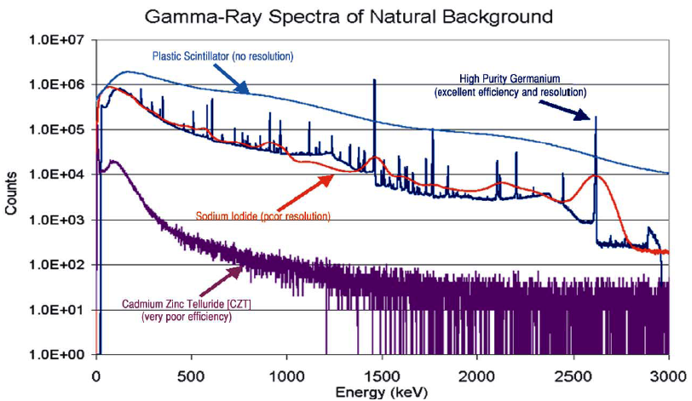
Background Spectra
http://www.ortec-online.com/papers/sup_hpge.pdf
Notes:
Can you explain the difference in the raw counts and peaks / resolution based off of your knowledge of detectors?

Slide 20
Correlation between rain and increased background
the top plot is for the total counts in the ²¹⁴Bi peak at 609 keV versus the time the spectrum was recorded on 7/27
peak activity is indicated
note that the increase in counting rates is about a factor of 6 or 7
the bottom plot shows the hourly precipitation versus time on 7/27
the peak of the rain precipitation matches well with the peak of the increased activity in the ²¹⁴Bi peak
apparently the rain is associated with an increase of the radiation background
Why did the spectrum change?
Notes:
When rain started, the counts from the Bi-214 609 keV peak increased as can be seen by the comparison with rainfall rate
Why does the spectrum change ?
radon is the likely candidate for the increase in radioactivity after rainfall
radon gas decays into metals whose atoms oxidize and get suspended in the atmosphere as aerosols
a rainfall washes the suspended aerosols out precipitating to the ground
²¹⁴Bi has a 20 min half-life, so it does not persist long after the rainfall
the strong ²¹⁴Bi line at 609 keV may interfere with ¹³⁷Cs tests with a line at 662 keV if testing during or after a rainfall is anticipated

Slide 21
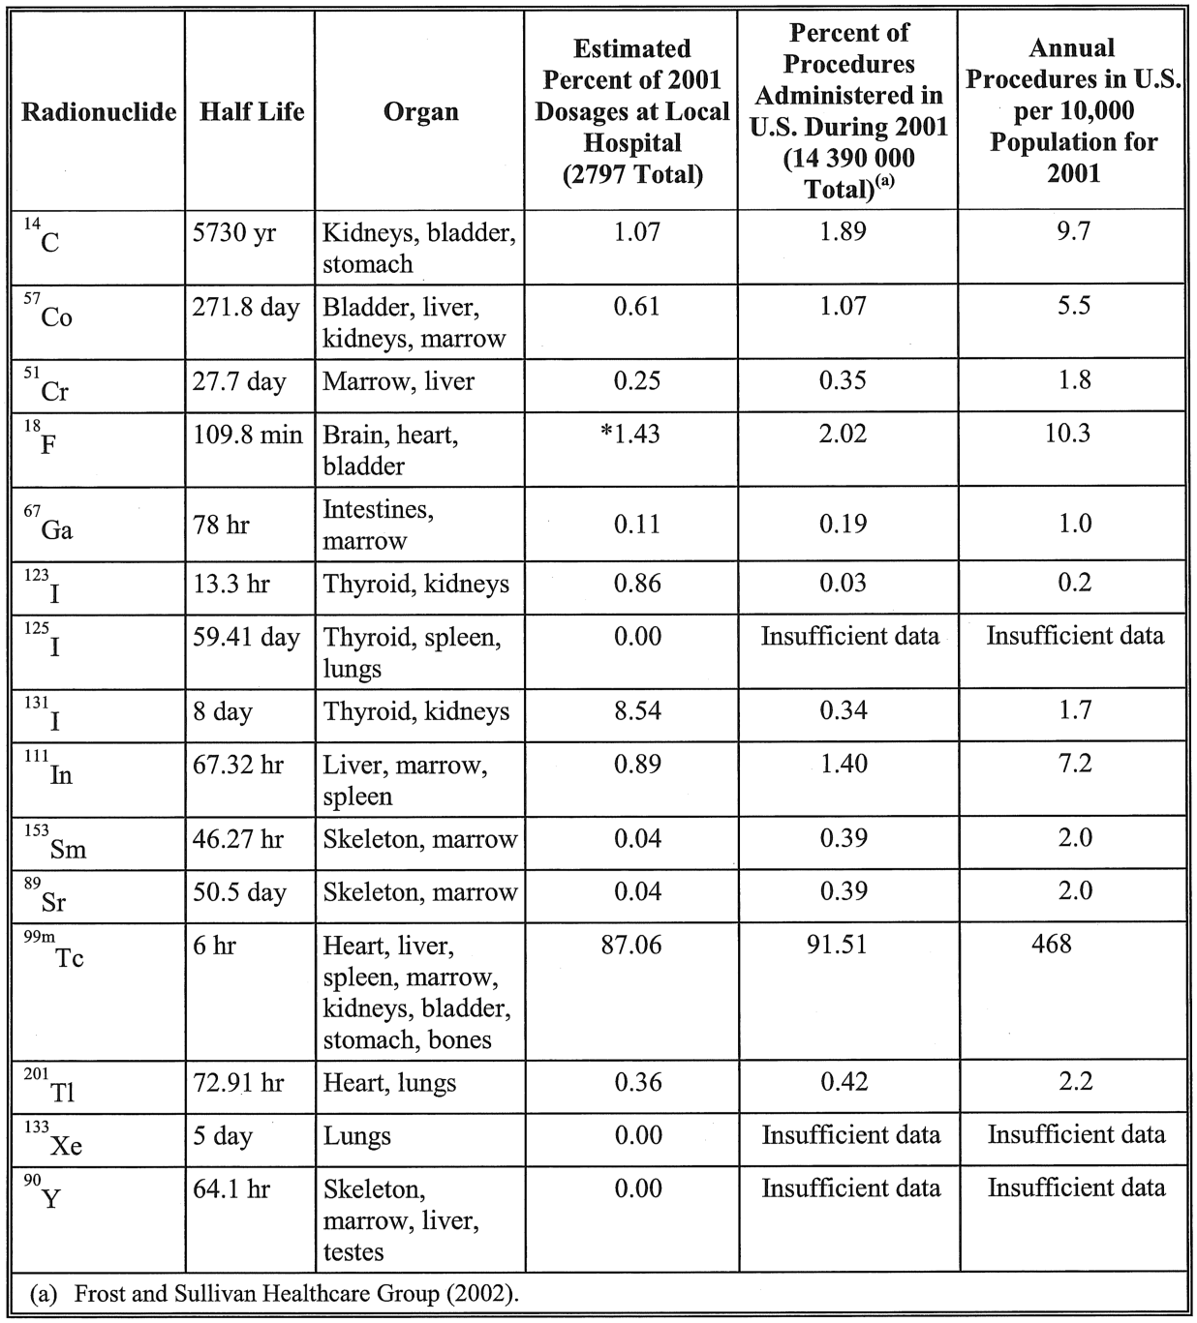
Medical radionuclide use
Notes:
Table 2-7 (Kouzes)

Slide 22
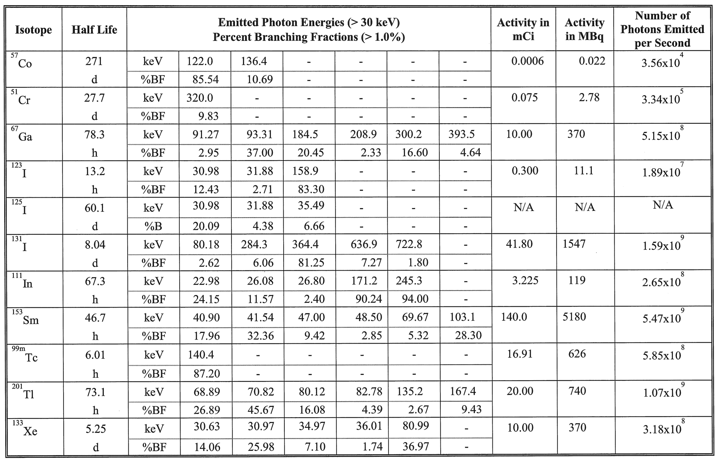
Decay properties of typical medical radionuclides
Notes:
Table 2-8 (Kouzes)

Slide 23
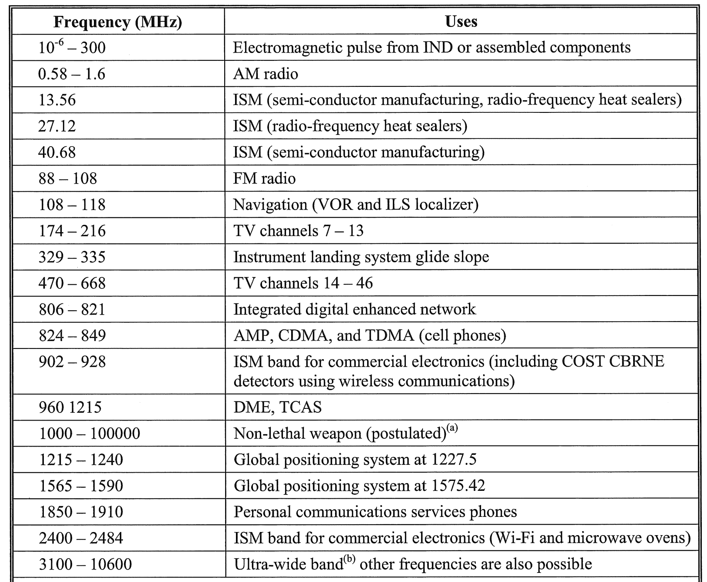
Frequencies of sources of electromagnetic interference
Notes:
Ref. Kouzes

Slide 24
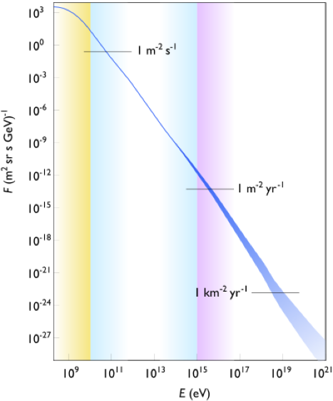
Cosmic rays
Primary cosmic ray spectrum
galactic and solar origin
incident energies of order up to ~Joules!
~90% protons
~10% nuclei up to Fe, traces of heavier nuclei
~0.1% gamma-rays
Rate of energy loss for muons: 2 MeV/(g/cm²)
vertical drop through atmosphere: 1000 g/cm² – muons lose ~2 GeV to ionization before reaching ground
mean energy at sea level: 4 GeV
deposits 50 MeV in 5 cm Ge
secondary particles chiefly neutrons
Notes:
Where do cosmic rays come from? The cosmos (including our sun!)
What kinds of particles make up cosmic rays? Heavy charged particles
Picture credit: Wikipedia
The energy loss for cosmic muons is about 2 MeV per g/cm2 of material
Background problem mostly when looking at neutrons. Rate is typically 1 per s in your hand

Slide 25
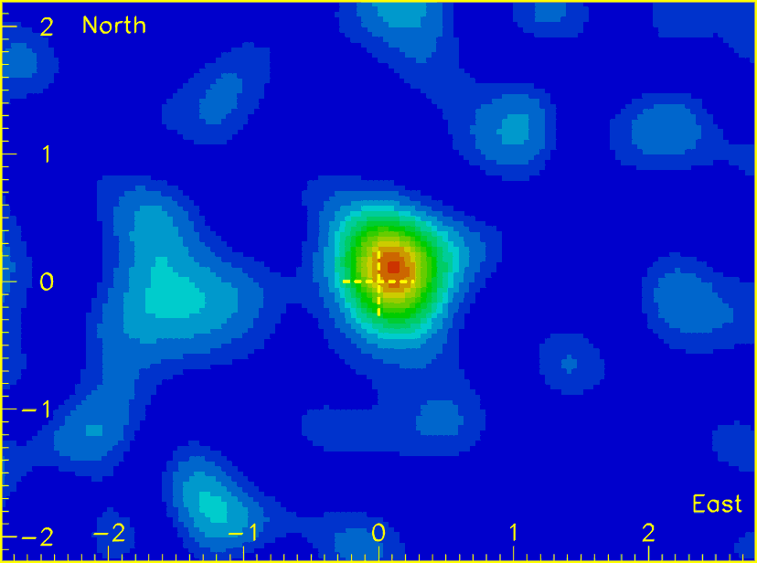
Cosmic muon stopping
Rate of energy loss for muons: 2 MeV/(g/cm²)
vertical drop through atmosphere: 1000 g/cm² – muons lose ~2 GeV to ionization before reaching ground
mean energy at sea level: 4 GeV
deposits 50 MeV in 5 cm Ge
secondary particles chiefly neutrons
Notes:
While the primary secondary particles are neutrons, the secondary particle flux on surface is a function of
latitude
weather
solar activity
diurnal cycle
barometric pressure
altitude (higher with elevation)
Note that longer path through atmosphere reduces flux reaching ground due to interactions with atmosphere.
The graphic to the right, bottom is a shadow from the moon interfering with the cosmic muon flux.
Source: LBNL Particle Data Group
http://pdg.lbl.gov/2011/figures/figures.html

Slide 26
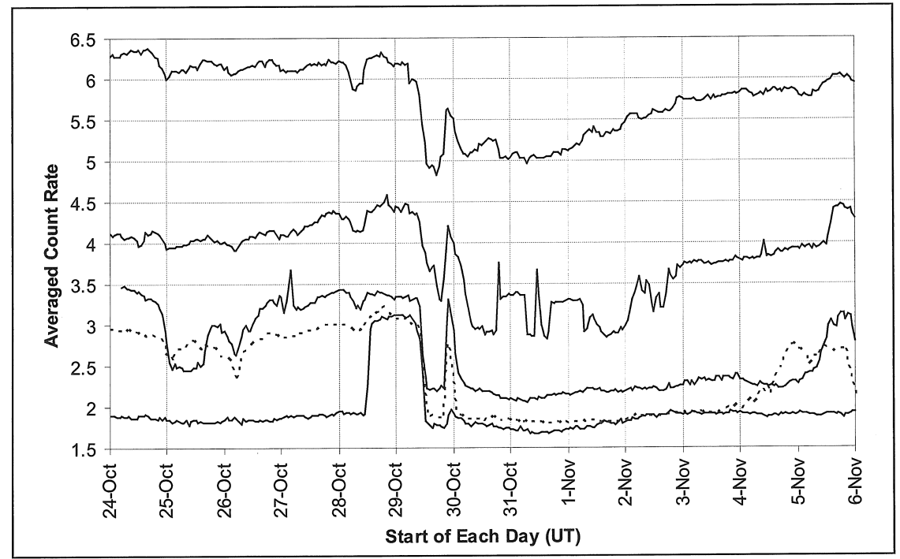
Solar Events impact Cosmic Radiation
lower energy; affected by solar-induced magnetic field
affected by the solar activity: 11-yr solar cycle, yearly cycle, diurnal cycle
protons accelerated by solar flares + high-energy neutrons produced in nuclear reactions in solar atmosphere
Notes:
Cosmic rays will obviously set off your detector (because of the amount of energy they deposit, they’ll likely be at the very high end)
The solar cycle affects the cosmic radiation we see here on earch.
Figure 2.6 Kouzes

Slide 27
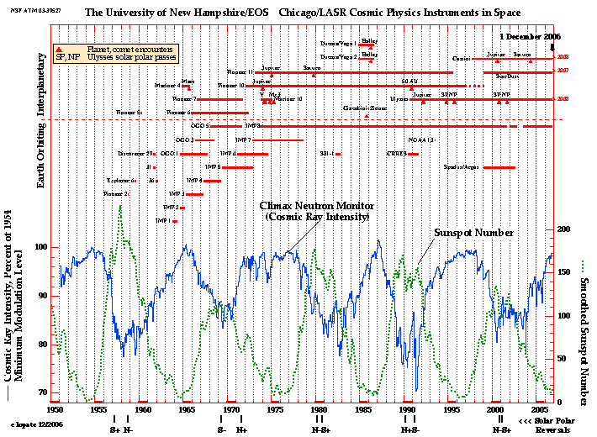
The 11-yr Solar Cycle impacts Cosmic Background
Notes:
Fig. U. New Hampshire and U. Chicago

Slide 28
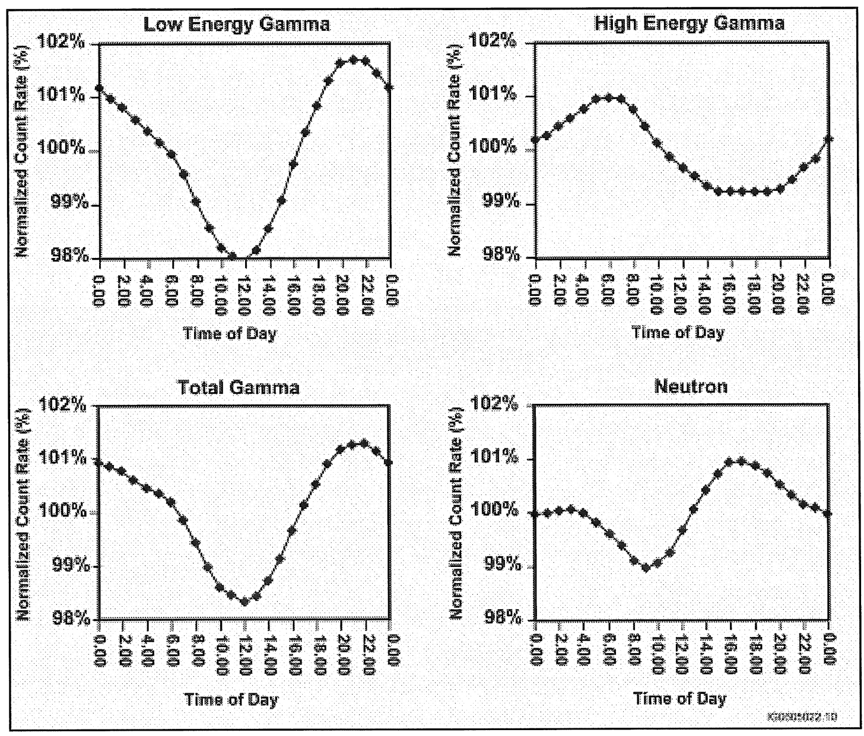
The Cosmic Background Changes with the Time of Day
Notes:
Figure 2-16 (Kouzes)
Average diurnal response of total gamma, high-energy gamma, and neutron background

Slide 29
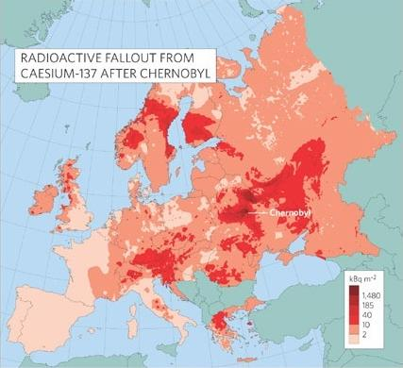
Fallout from the Chernobyl nuclear accident
Notes:
J. Smith and N.A. Beresford, “Chernobyl: Catastrophe and Consequences”, (Praxis, Chichester, 2005)

Slide 30

Fallout from the Fukushima nuclear accident
Notes:
Ref: http://www.nnsa.energy.gov/

Slide 31
Why can it be hard to distinguish signal from background?
Radiation signatures produced by SNM (gammas and neutrons) are weak since spontaneous decay is relatively rare and the emission is isotropic.
Rate ~ 1/r²
Detection of SNM is not necessarily a detector sensitivity/efficiency problem, but rather a signal to noise ratio (SNR) problem!
Approaches to increase signal to noise:
high energy resolution (gammas)
directionality/high angular resolution (both gammas and neutrons)
time resolution (in active interrogation)
neutron/gamma multiplicity

Slide 32
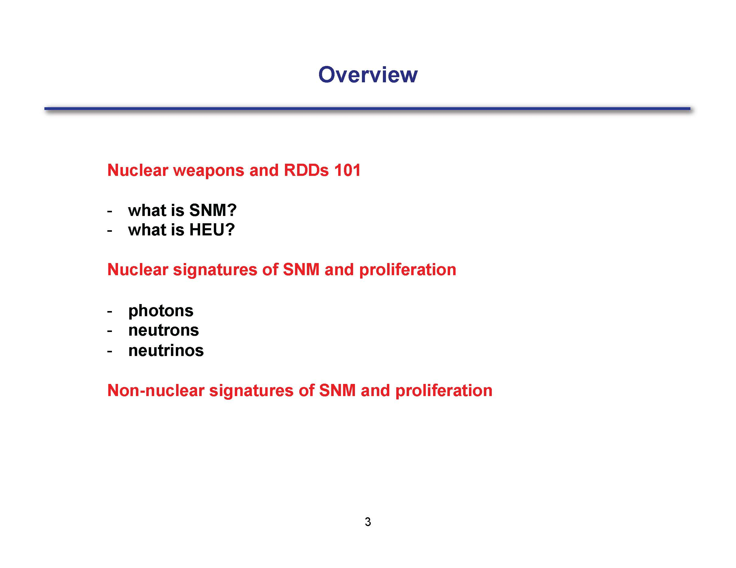
Notes:
Here is a basic breakdown of what this block of instruction covers.
In your own words, what is special nuclear material?
Can you describe the isotopics of natural uranium?
0.72% 235U, 99.273% 238U, and traces of 234U
What is slightly-enriched uranium?
~0.9-2%
What is low-enriched uranium?
2-20% 235U
What LEU levels are used in LWRs for power and for research reactors?
3-4% is common for LWRs and 12-20% for research reactors
What is HEU and WGU?

Slide 33
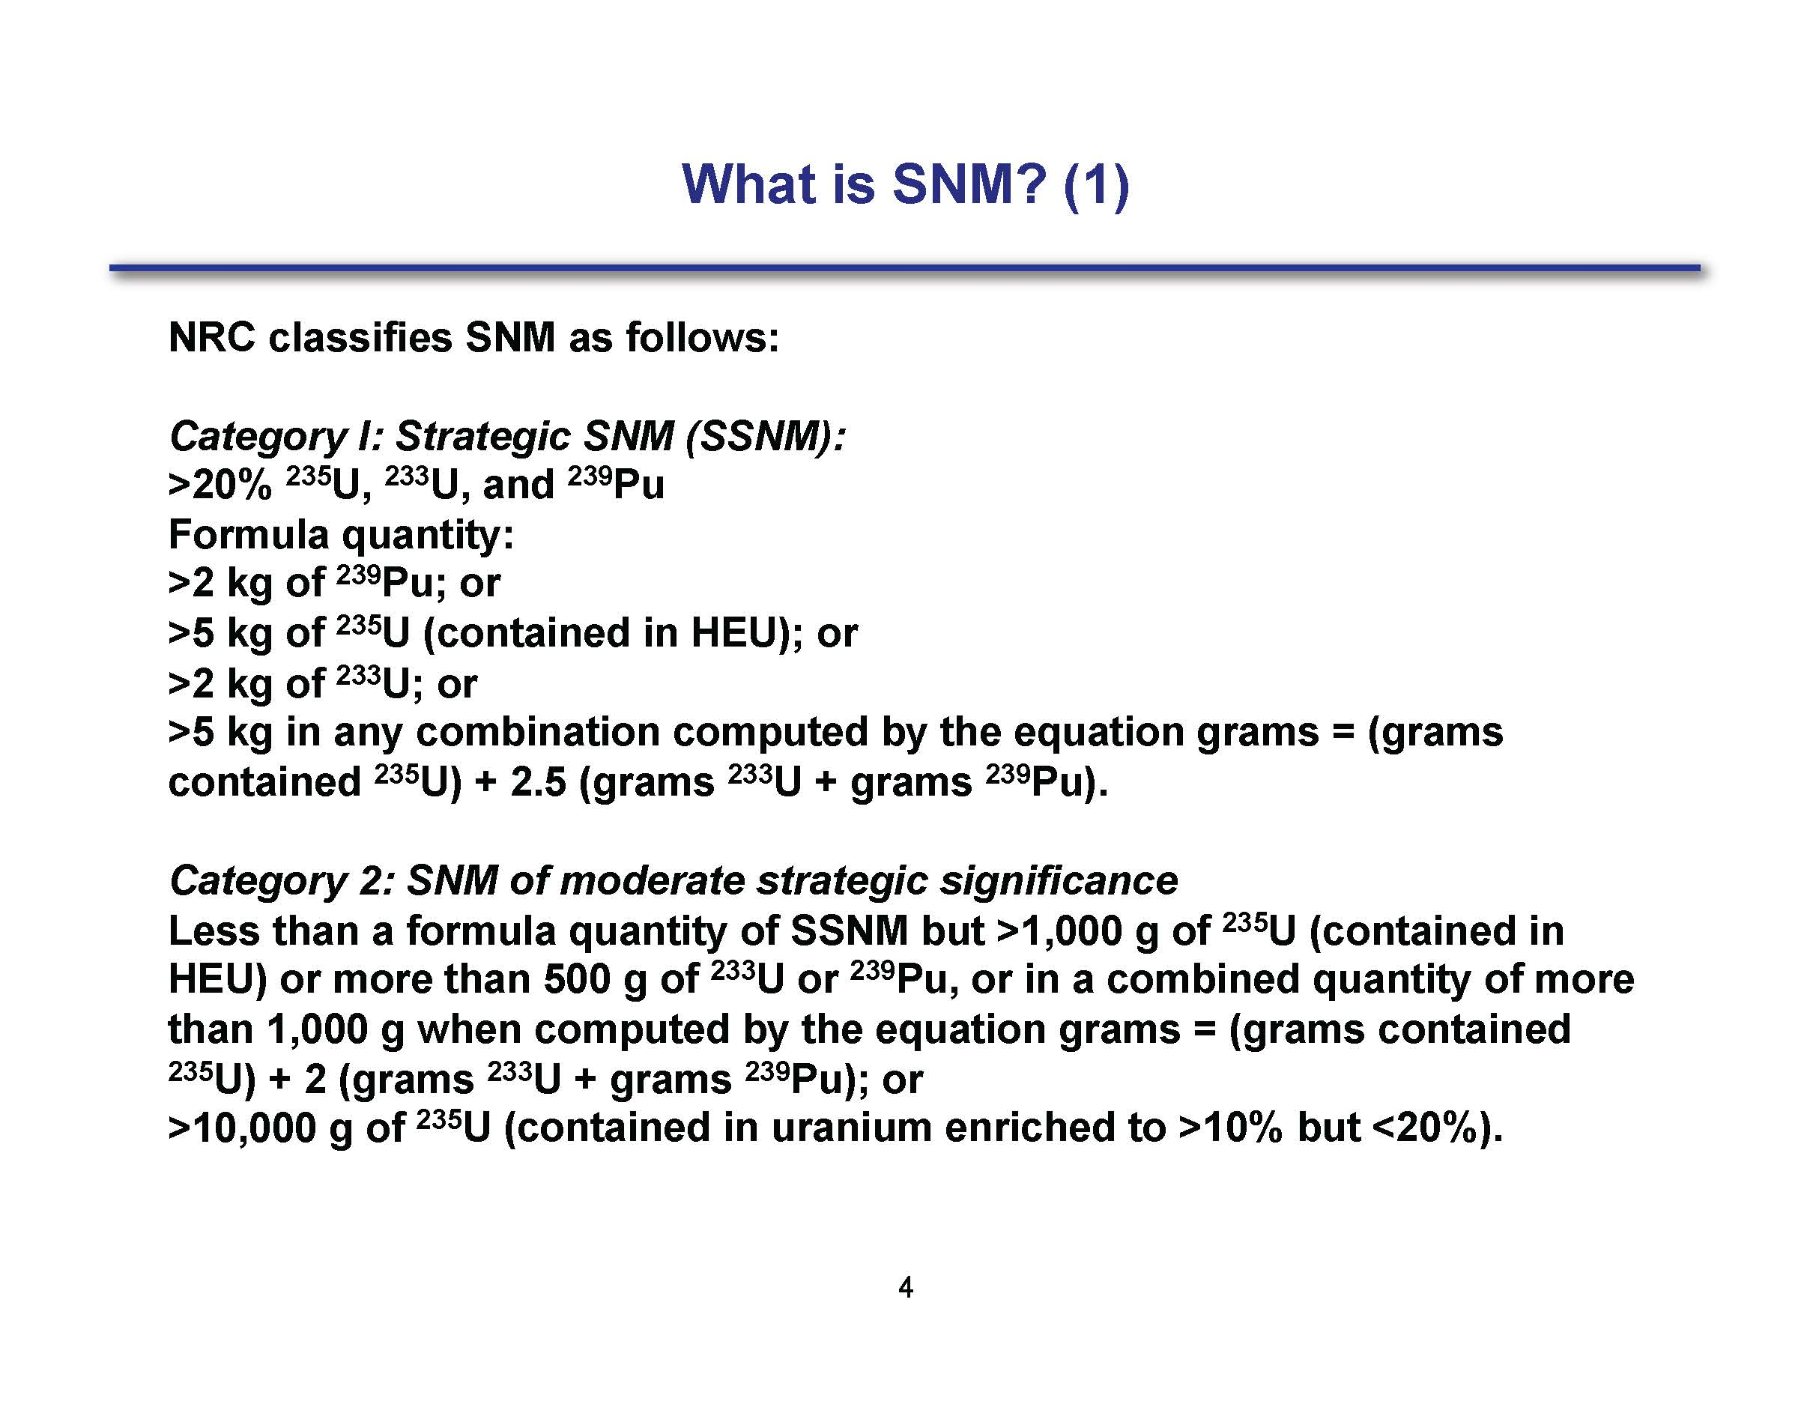
Notes:
The main point of these two slides (this and the next) are that the NRC has a classification methodology for different amounts and enrichments and combinations of materials.
I don’t expect you to “memorize” these definitions although, depending on your job, this might come in handy.
The main point is to understand how the NRC classifies SNM.

Slide 34
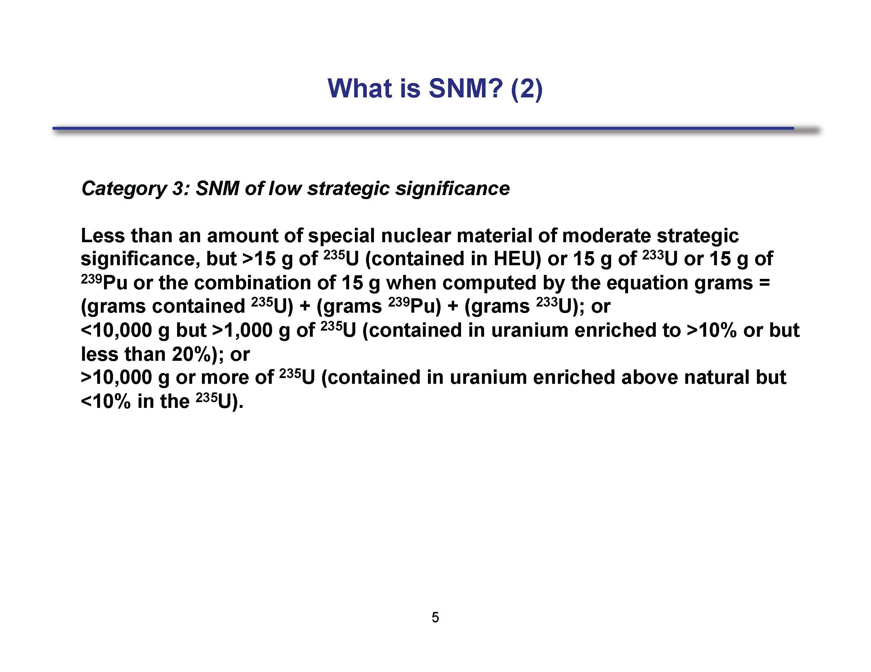

Slide 35
Uranium
Natural:
0.72% ²³⁵U, 99.273% ²³⁸U, traces of ²³⁴U
Depleted:
< 0.72% ²³⁵U
Low-Enriched (LEU):
3-4% for use in LWRs
12-20% for use in research reactors
Highly-Enriched (HEU):
> 85% for WGU
> 20% is HEU
Notes:
What is fissile material and why do we care about it?
Those isotopes that fission with thermal neutrons
What is fissionable material and why do we care about it?
Those isotopes that fission with fast neutrons.
What is fertile material and why do we care about it?
Those isotopes that can be used to breed fissile material.

Slide 36
What is fissile/fissionable material and why do we care about it?
Fissile material fissions with a thermal neutron
Fissionable material fissions with a fast neutron
Fertile material can be used to create fissile material
We care about
Fissile material because it is essential for creation of nuclear explosives
Fissionable material because it can also be used in weapons
Fertile material because it can be used to obtain fissile material
Pu is preferred for compact weapons but requires more complex design
U is easiest for improvised nuclear devices
Notes:
We should keep in mind that one of the things that makes HEU such a risk is that much (most) of the work has been done to enrich it.
Keep in mind that the work needed to take HEU to WGU is less than what it took to get to HEU from natural uranium.
Do you understand why Pu is preferred for compact weapons?
Do you understand why Pu cannot be used for a gun-type weapon?
Do you understand why it is easier to create an IND using U (instead of Pu)?

Slide 37
SNM Stockpiles
Many thousands of tons of WGU and separated WGPu currently in weapons and nuclear weapon complexes
Many tons of HEU is reserves
IAEA significant quantities:
8 kg Pu & 25 kg ²³⁵U
Three paths to SNM
Enrichment—isotope separation
Reprocessing
Stealing, buying or otherwise obtaining it
Notes:
The amount of enriched materials that exists in stockpiles, particularly among the NWSs (especially Russia and the US) is massive.

Slide 38
Pu Isotopics
²³⁹Pu is the first isotope produced after ²³⁸U(n,g)
The longer the Uranium is left in the reactor the higher the probability that the Pu will absorb another neutron and either fission or be converted to ²⁴⁰Pu
Higher burnup leads in a shift of the Pu isotopics toward heavier isotopes
²⁴⁰Pu/²³⁹Pu ratio is an indicator of both the burnup of the U-fuel and the amount of U needed to produce a given quantity of this Pu
What does an elevated level of ²³⁸Pu indicate about the type of fuel used in the production reactor?
What does the presence of ²³⁸Pu in the fuel indicate about what fuel was used to create the Pu?
Notes:
You should have learned most of this in the last lecture.
What is new is the presence of 238Pu. This indicates that the reactor was fueled with recycled uranium.
How does the 240Pu/239Pu ratio indicate both the burnup of the fuel and the amount of U that is needed to produce a given quantity of Pu?
An elevated 238Pu content is a clear indicator that the production reactor was fueled with recycled U containing 236U.
What does the presence of 238Pu in the fuel indicate about what fuel was used to create the Pu?
If reprocessed U is fed into enrichment plants to make HEU, the isotopics of the fissile materials produced with this strategy (first Pu, then HEU) allows consistency checks between declarations of the two materials

Slide 39
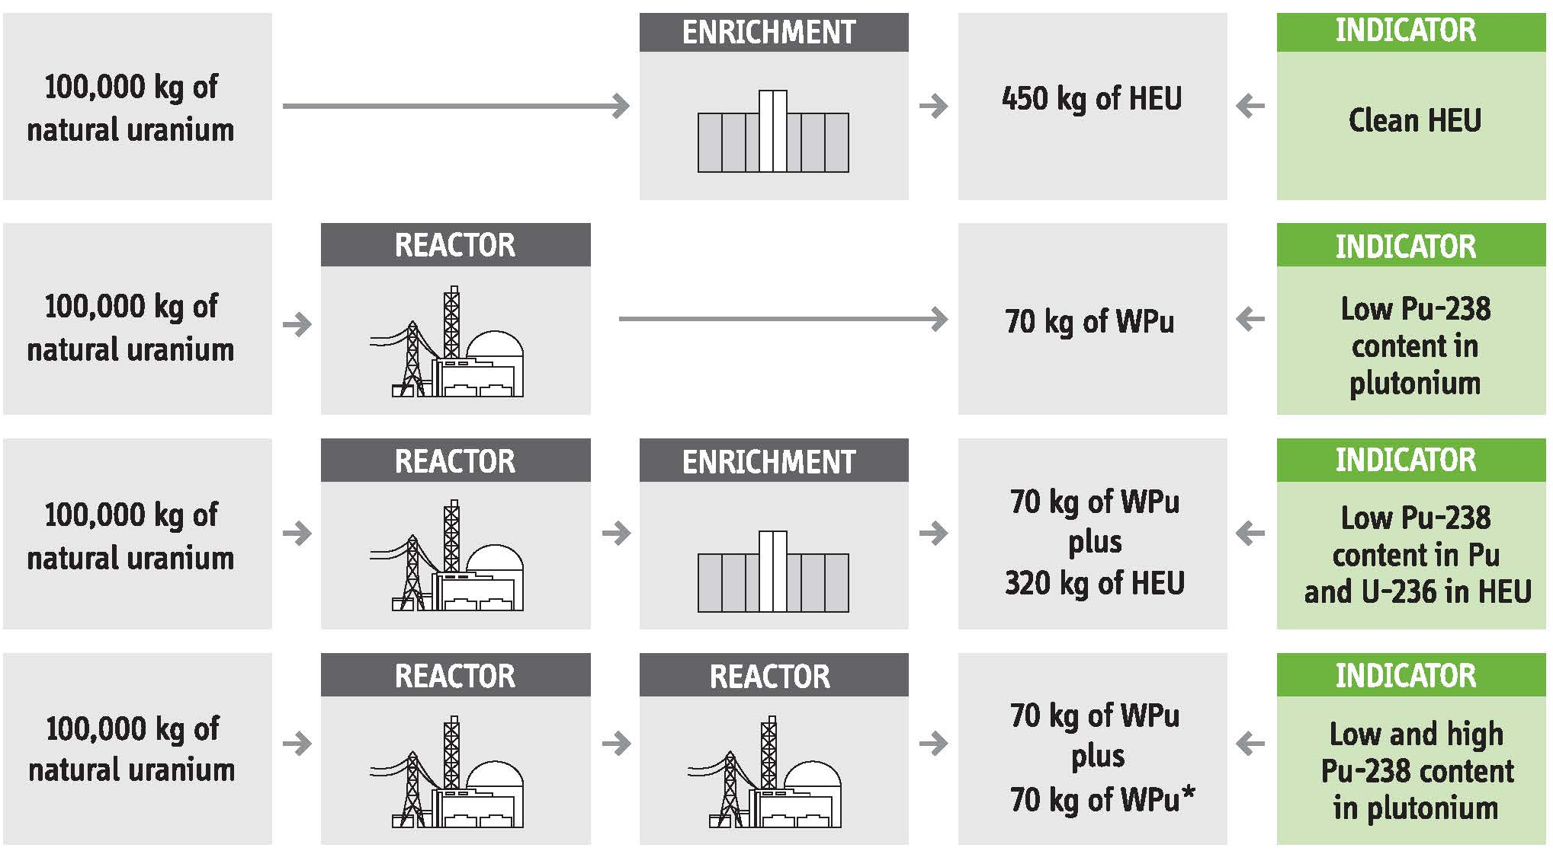
Fissile Material Production Modes and their Indicators
Notes:
Here are some different indicators for difference fuel histories
(1) Natural U enriched. Why do you have clean HEU?
You get “clean” HEU because there are no “bred” materials present,
(2) Natural U put through a reactor yields a fuel with low-²³⁸Pu content. Why is there low 238Pu content?
Since the natural U has been through a reactor, there was now 236U present from which to breed 238Pu
(3) What does the third case tell us?
Natural U through a reactor and then enriched yields a fuel with low 238Pu content since there wasn’t much ²³⁶U present to breed ²³⁸Pu. Also, you have low 236U content.
(4) What does the fourth case (Natural U through a reactor and then through a reactor again) tell us?
You can get variable 238Pu content in the Pu depending on the reactor operating history.

Slide 40
Reprocessed U Isotopics
What two artificial isotopes are present in U fuel?
How can we tell that an enrichment cascade has been fed with U that has been recovered from spent fuel from a Pu production reactor?
The isotopic concentration of 232U, 236U, and 235U depends on:
Isotopic makeup of the reprocessed U
Fraction of reprocessed U in the enrichment plant feed
Product enrichment and tails depletion of the plant
The type of enrichment technology deployed
If all this information is declared, the 232U and 236U contents of the HEU and DU can be computed and checked against measurements and samples.
In this way, declarations of cross-fed material link the Pu and HEU declarations and isotopics
Notes:
What are the two artificial isotopes present in reprocessed U fuel?
236U from 235U(n,g)
Trace 232U from (n,g) on a decay product of 235U
How can we tell that an enrichment cascade has been fed with U that has been recovered from spent fuel from a Pu production reactor?
When an enrichment cascade is fed with U that has been recovered from spent fuel from a Pu production reactor 232U and 236U are enriched.
Critical information on this slide:
Reprocessed uranium has two artificial isotopes: 236U and trace 232U.
If you find (e.g. seize from the black market) you can look at isotopics and determine if the fuel has ever seen a reactor.
You can also garner information about the type of reprocessing the fuel may have gone through which helps you to identify potential sources of the material.
You can also check these against known samples.

Slide 41
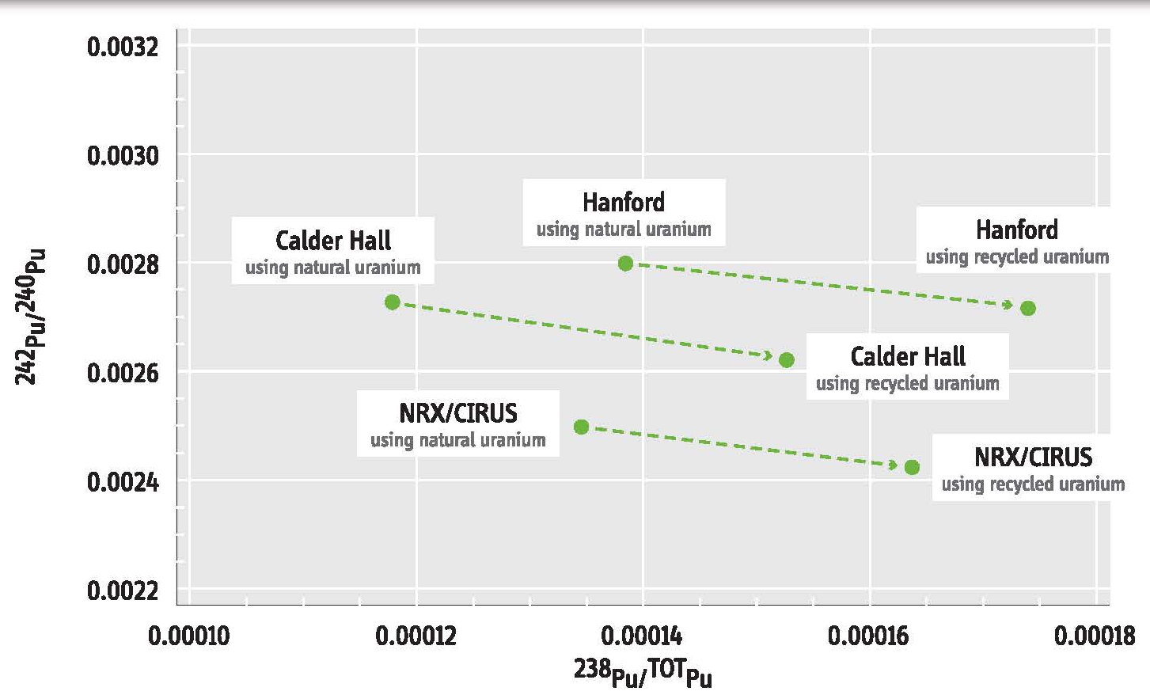
Reprocessed U Isotopics
Notes:
This graphic intends to show that you can look at isotopics to determine fuel history (well, at least differentiate and possible rule out some possibilities).
The impact of using natural versus recycled uranium fuel on the isotopics of Pu from various types of production reactors is shown.
An elevated 238Pu fraction is an indicator that recycled U was used.
The extra Pu is produced from 236U in recycled Uranium.
236U (an artificial isotope) is absent in natural U but is produced by neutron absorption in 235U during Pu production.
Why does the NRX/CIRUS using recycled U appear to the bottom right?
It has a higher 238Pu to TotPu ratio from breeding with the 236U. It has a low 242Pu/240Pu content.
Why does the Calder Hall using natural uranium appear at the top left?
It has minimal 238U because the initial content of 236U was low and only minimal breeding occurred.
The fuel must have 238U in it and it was radiated long enough to yield higher Pu isotope content.
What are some useful atomic and nuclear signatures for SNM detection?

Slide 42
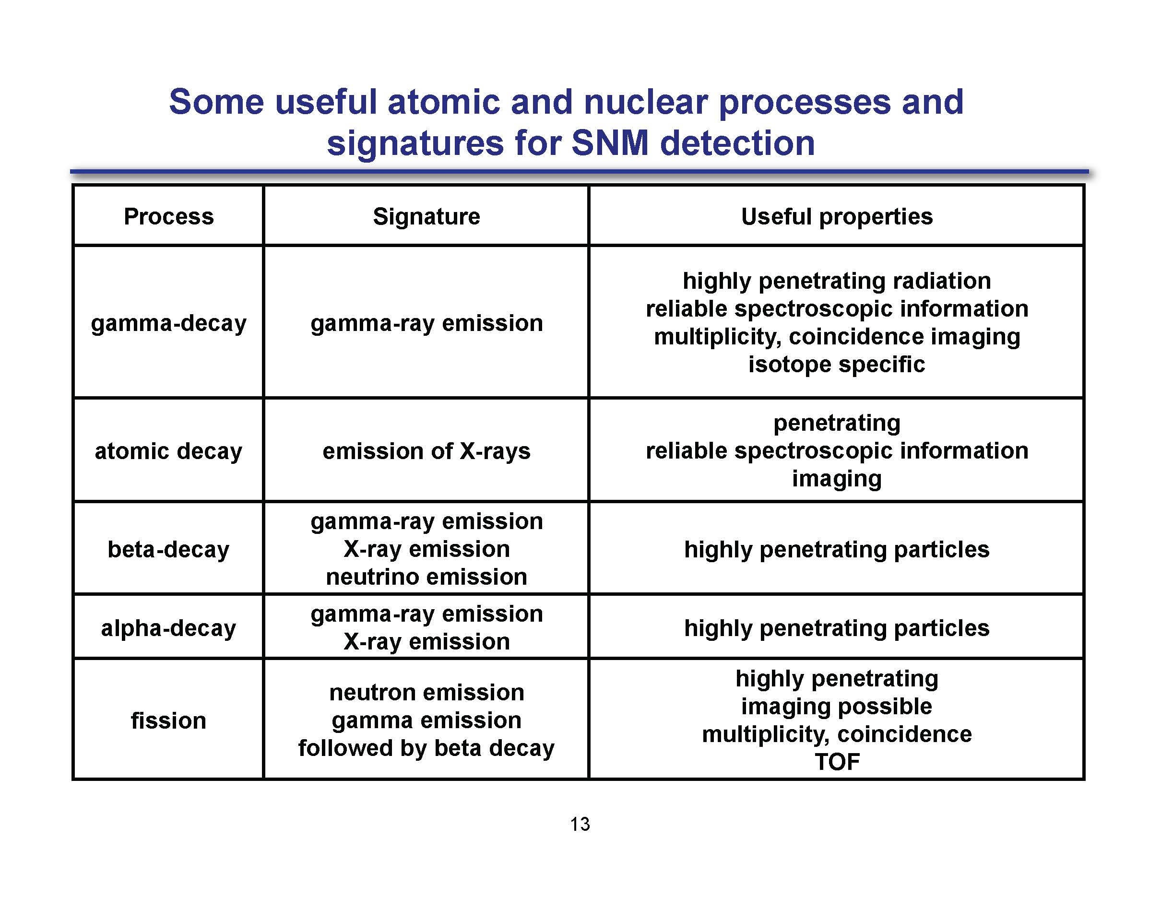
Notes:
There will be a lot of hidden slides after this which Nukes may want to review and non-nukes will want to study.
Here are the key points:
Gamma rays (a type of photon) and neutrons (not listed) are very penetrating and can travel a long way.
X-rays (which are photons of lower energy) are not very penetrating so they can be easily shielded. They are characteristic of the material they are emitted from.
Beta decays (are electrons emitted during a beta decay) and they don’t travel very far in matter (can be shielded by a think slab of metal).
Alpha particles (are helium nuclei emitted during alpha decay) and don’t travel very far in matter (can be stopped by dead skin or a sheet of paper).
Fission products are very energetic and travel tens of microns in matter. However, they are left in a very excited state and can emit energetic gammas, betas, and (a tell-tale sign of the presence of SNM) delayed neutrons.
Which possible signatures are useful for passive detection of a nuclear weapon?
Higher-energy gammas (from isotopic decays) and neutrons (both prompt and delayed)
Which signatures are not as useful for passive detection of a nuclear weapon?
Why is alpha detection so useless?
Why is emission of x-rays or beta particles not so useful?

Slide 43
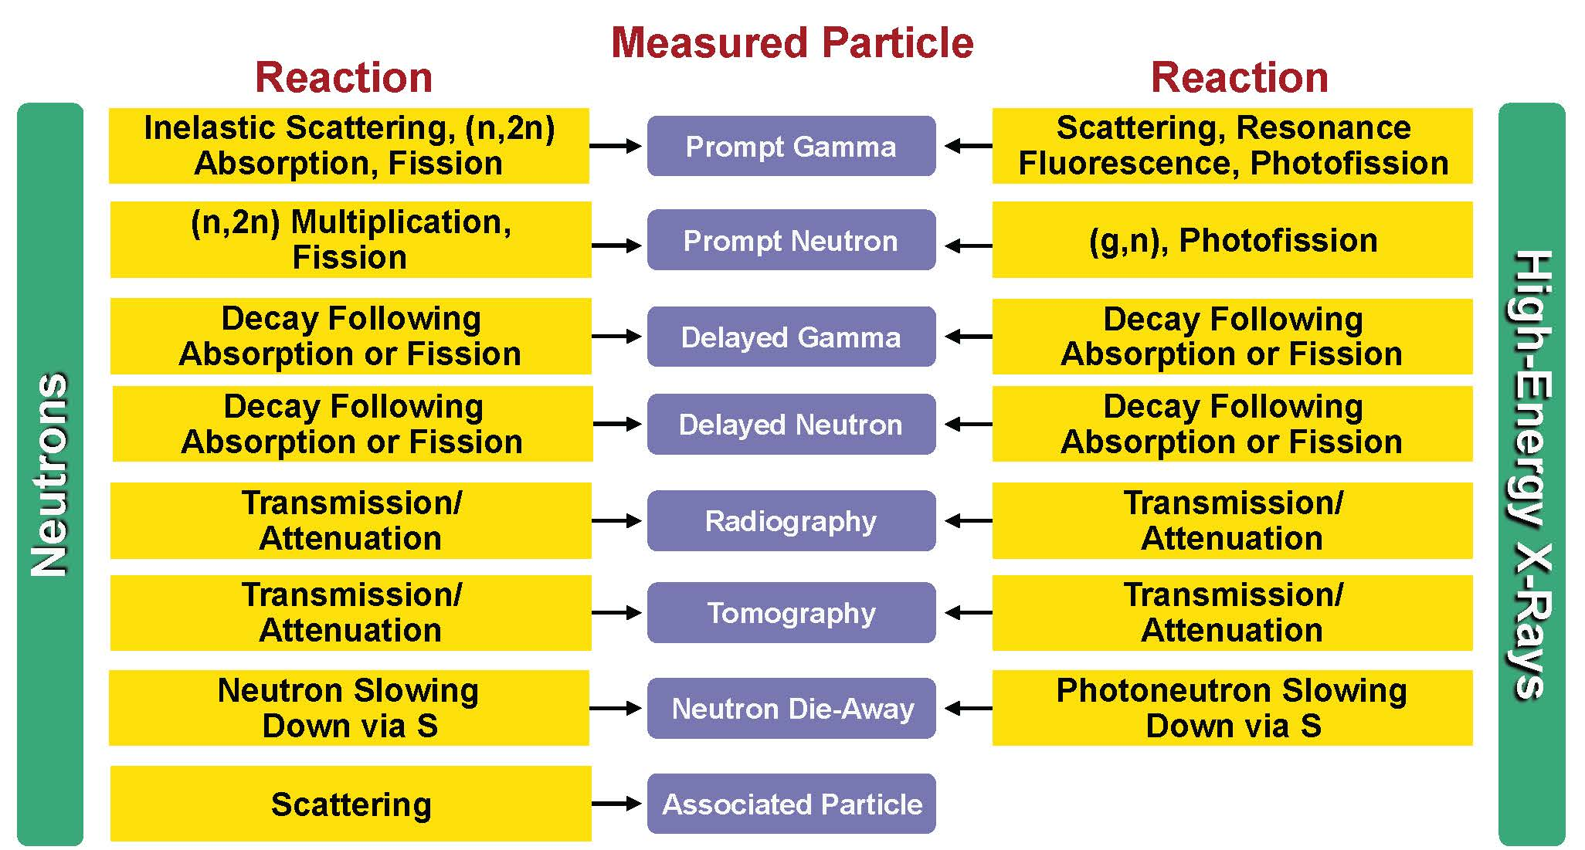
Available Signatures for Neutrons and Photons
Notes:
Here are some of the reactions that take place
As you go through this (and subsequent) lecture, thing of how the different “measured particles” may be easy or difficult to detect.
Which of these methods could not be used for passive detection?
Delayed neutrons. You can’t tell if a neutron is delayed or prompt (unless you are inducing fissions (say pulsing) and then looking)
Why would we consider detection of prompt gammas?
If you have a strong gamma-emitter with a reasonably high energy, you might have a chance to see it.
What is meant by transmission / attenuation?
What is meant by associated particle reactions?

Slide 44
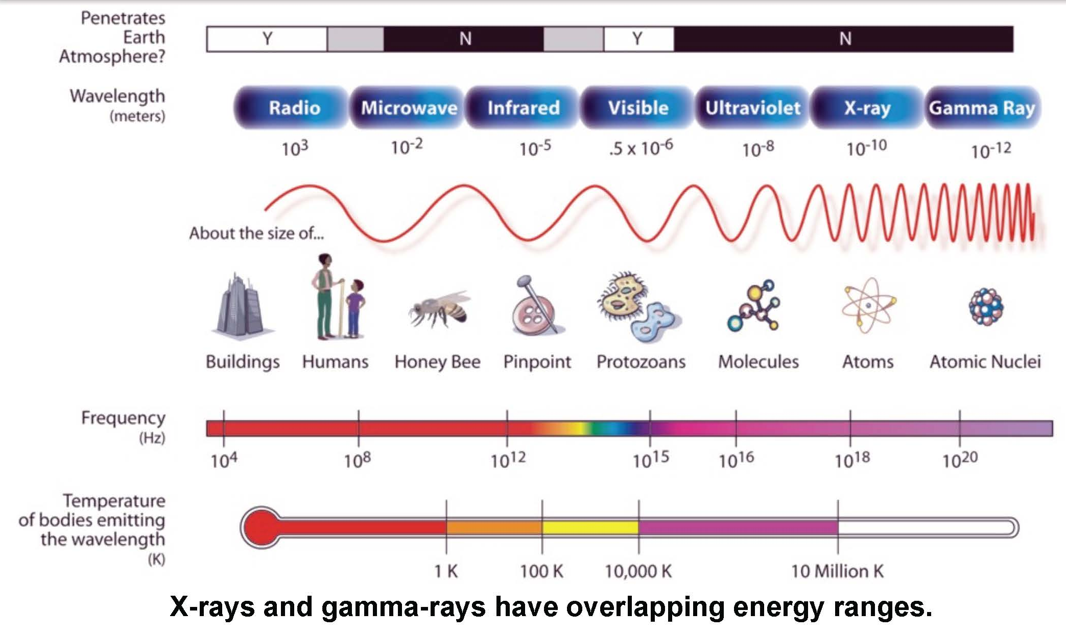
The Electromagnetic Spectrum
Notes:
This is a neat graphic because it relates energies (through the wavelength / frequency) and temperatures.
You don’t really need to “know this” for this course, but this is always something interesting to have in your tool kit.
Ever wonder why you stand in front of a microwave and you can see the food get hot and boil but you don’t get hot?
The holes you are looking through are very large compared to the wavelength of the visible light so the light can pass right through them.
The microwaves (ten cm or so wavelength) don’t see the holes; they see a barrier so they can’t get out to zap you!

Slide 45
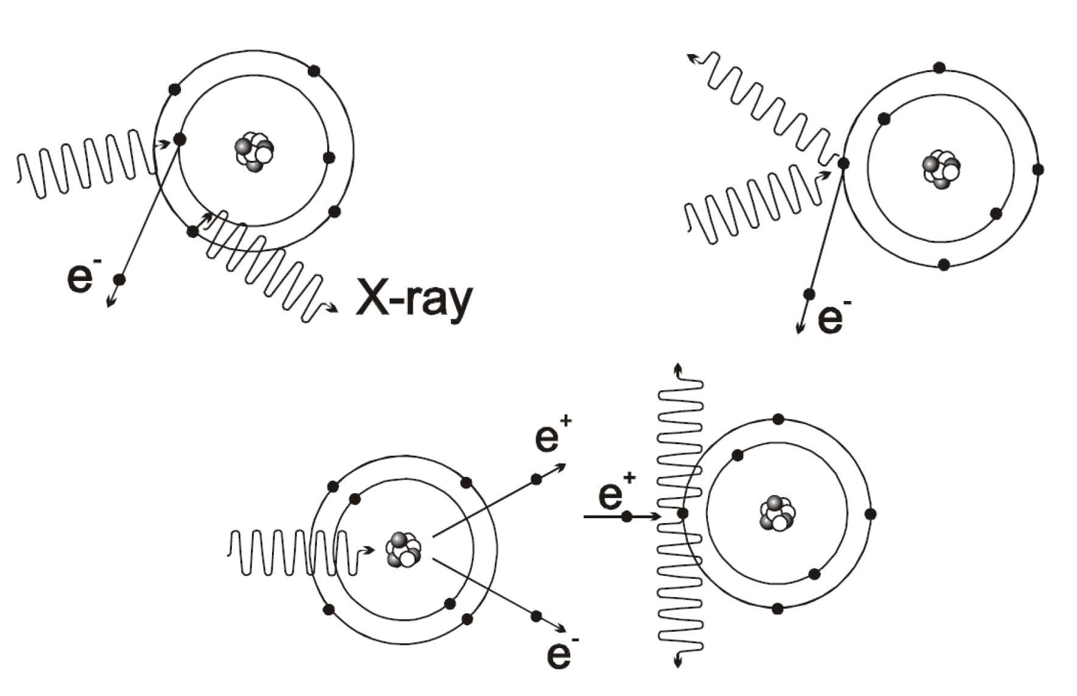
Photon Interactions with Matter
Notes:
What are the three types of photon interactions shown here?
top-left: Photoelectric effect → Photon goes in, gives its energy to ionizing an electron, and characteristic x-rays come out
top-right: Compton effect → photon goes in and a photon and energetic electron come out.
bottom: Pair production → photon goes in and interacts with EM field and an energetic electron and positron (anti-matter particle for electron) go out.
For what energies does each interaction type dominate and how does interaction probability change as a function of material Z for each of the interactions?
Photoelectric effect dominates at lower energies (and higher Z, approximately Z^3.5)
Compton medium energies (uniform for all Z)
Pair production at higher energies (and higher Z)
Why does the fate of the photon matter to the signature / detection problem?
While gammas generally have a longer range in matter (well, at least for higher energy gammas) electrons do not travel very far in matter and are difficult to detect.
Lower energy photons, like x-rays, can easily be shielded with a small amount of high-Z material
Energetic photons will emit a portion of their energy as bremsstrahlung radiation, which is low energy and easily shielded. This makes detection more difficult.
If we have pair production, the flux of mono-energetic photons we may be looking for will be reduced.

Slide 46
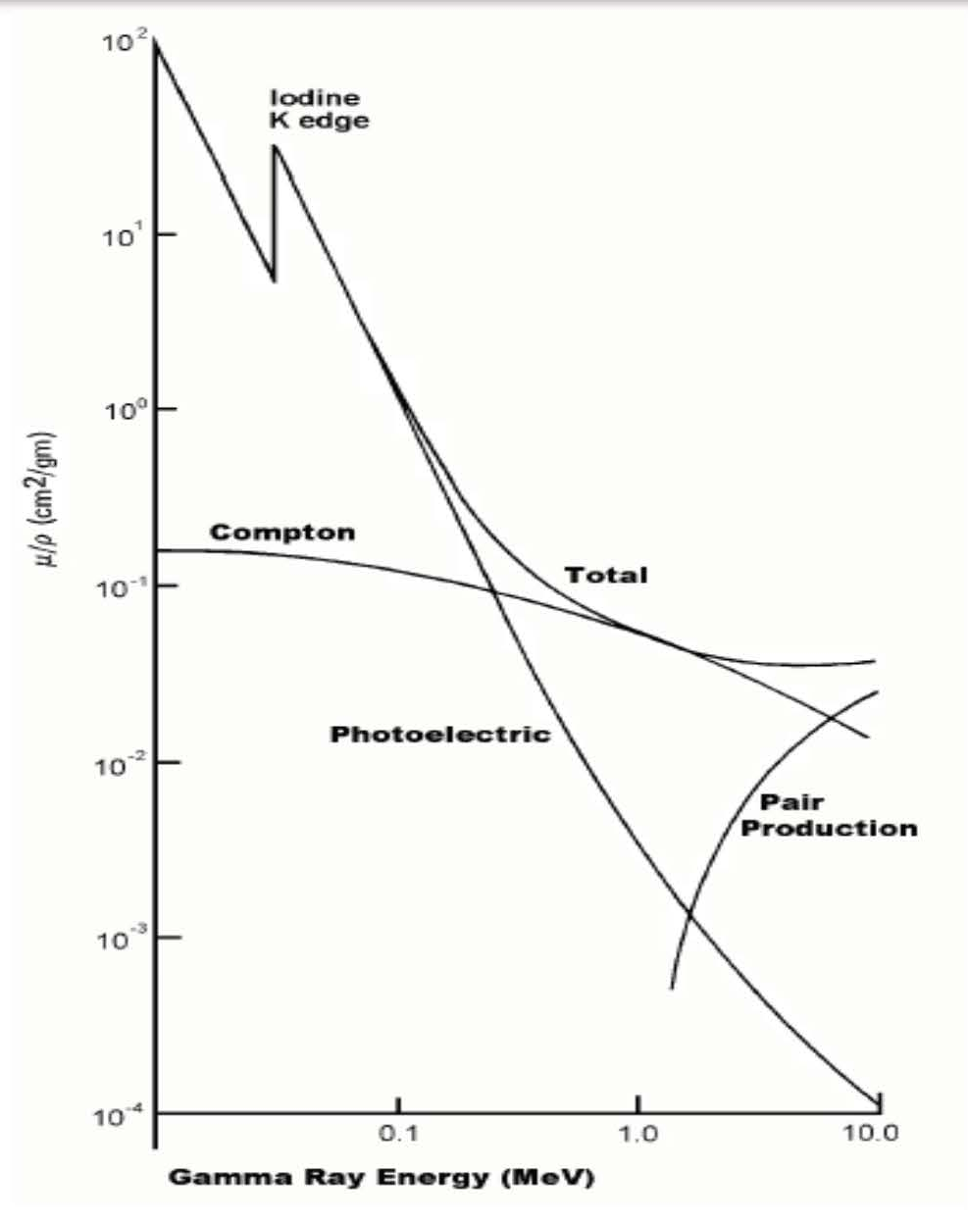
Energy Dependence of Interaction Coefficients
Notes:
Note the log-log scale here.
Key points:
Photoelectric effect dominates at lower energies (and higher Z, approximately Z^3.5)
Compton medium energies (uniform for all Z)
Pair production at higher energies (and higher Z)
As a nuclear engineer, you should have a very good understanding of the different types of photon interactions.
While there is the “detection” problem to look at, we also need to consider the shielding problem.

Slide 47
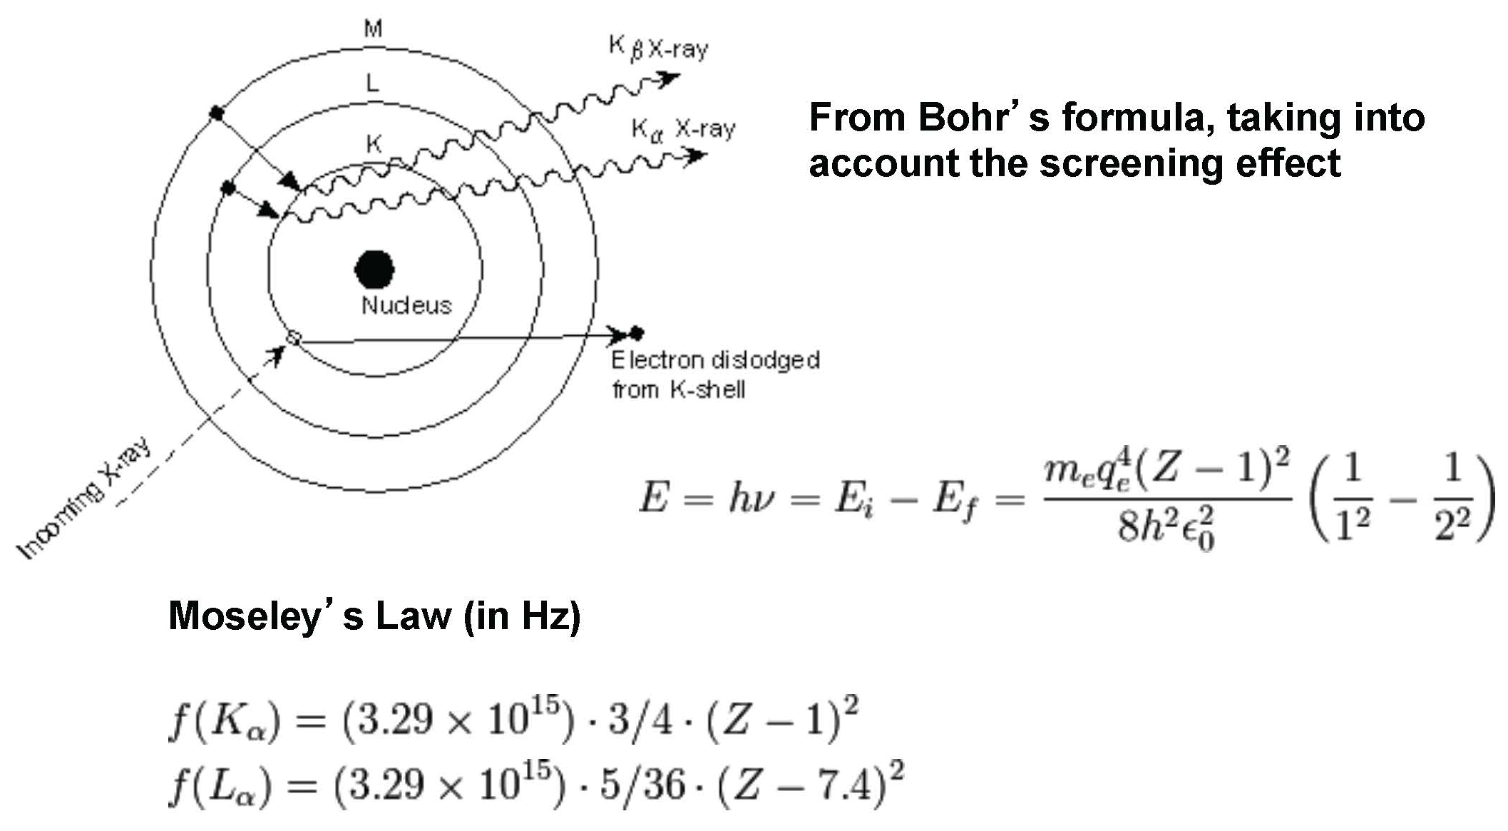
Production of X-rays
Notes:
Where do x-rays come from?
X-rays originate from an electron moving from a higher to a lower shell. These are characteristic of the isotope.
X-rays originate from breaking radiation (bremsstrahlung), which occurs when a light charged particle (electron or positron) is accelerated, changes direction, and transfers momentum/energy to a photon.
What are the typical energies for x-rays originating from atomic transitions?
Order of eV to many keV

Slide 48
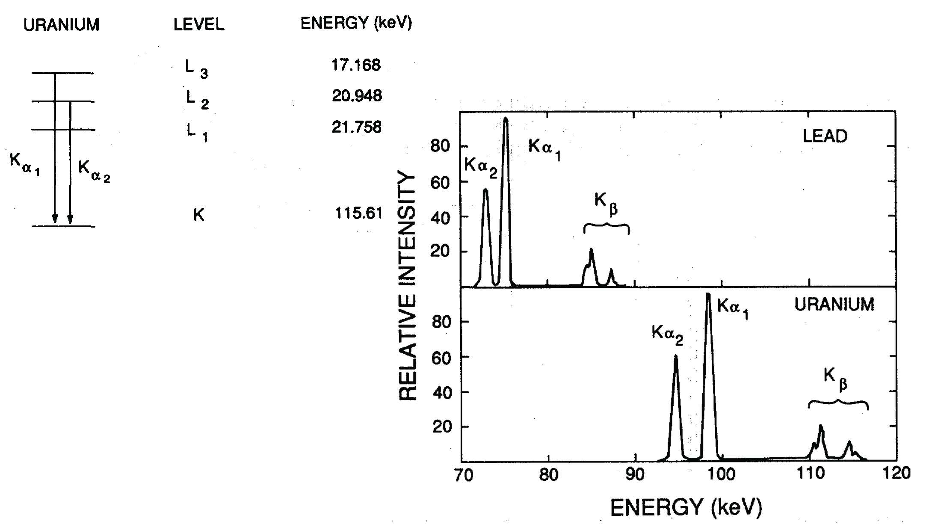
X-rays from Uranium
Notes:
This is not a lab class nor is it an atomic or nuclear physics class. However, you should be aware that when the electron moves from one shell to a more tightly bound shell, the energy difference is given off as a photon. (Of course, a miniscule portion also goes into recoil but it can be ignored at these energies).
The alpha values basically mean a K-shell final state. Alpha-1 is from L- to K-shell.
The beta values are from a higher shell to an L-shell and so on.
Under what conditions might X-rays, which we know can be easily shielded, be useful for forensics?
Since materials have characteristic x-rays, we can used them to identify isotopes present in a sample
Looking at something in the lab is a different story. You can physically modify what you are looking at (i.e. take away shielding or cladding material)
We will see that 235U has a characteristic x-ray that is of interest to us when we are trying to determine the presence of 235U.

Slide 49
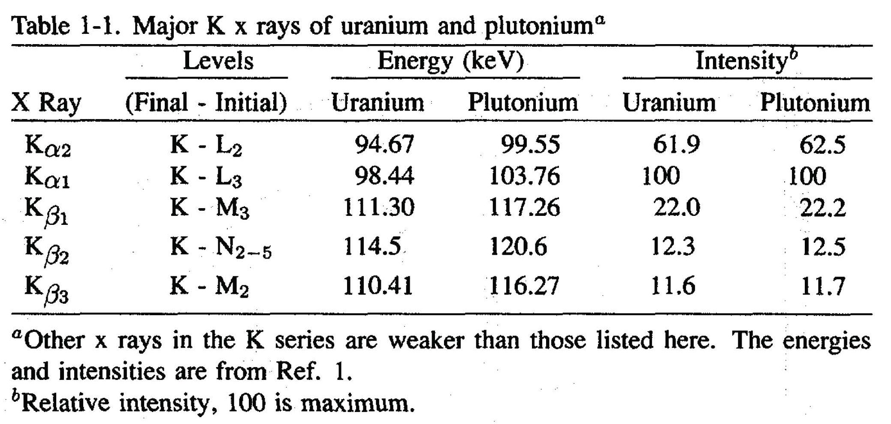
X-rays from SNM
Notes:
What kind of detector do you need to identify x-rays? Can you do it with a scintillator or do you need a semi-conductor? Why?
The resolution of a detector is ultimately driven by the number of charge carries at the limiting step.
The amount of energy needed to collect one charge carrier is approximately 3 eV for a semiconductor, 30 eV for a gaseous detector, and about 200-300 eV for a scintillator. Obviously, the semiconductor will have the best resolution.

Slide 50
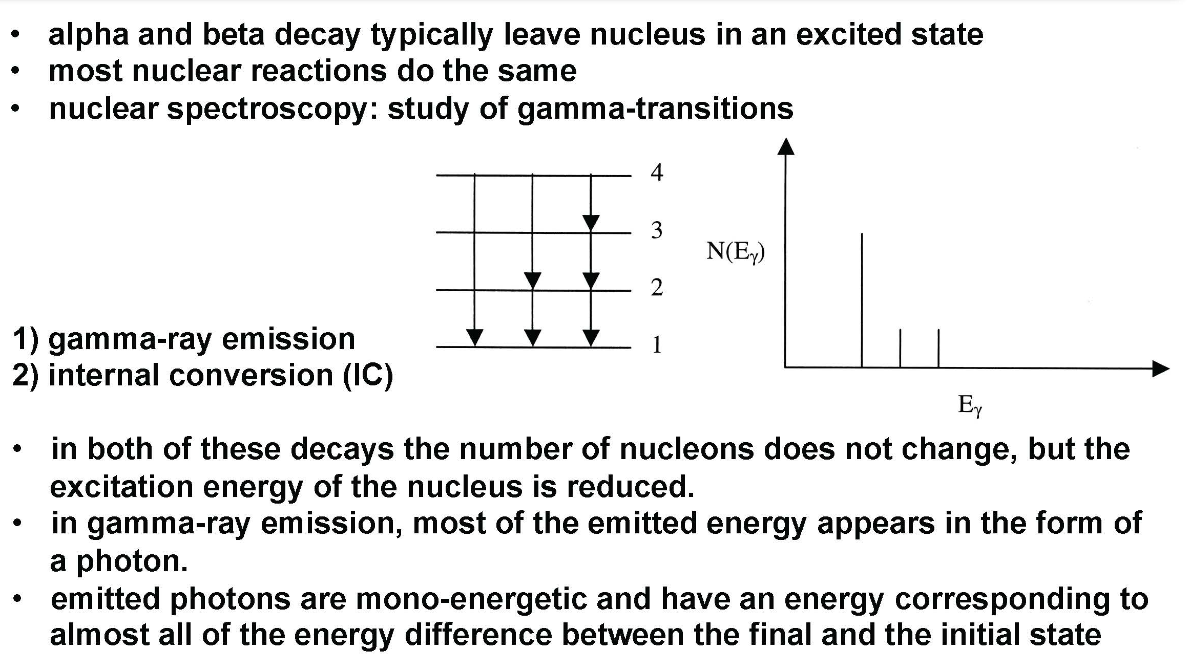
The Basics of Gamma (Electromagnetic) Decay
Notes:
Do you understand how the energy-level diagram to the left (4, 3, 2, 1 decays) relates to the spectrum to the right?
What is the first peak and why is it higher?
The 4-3, 3-2, and two 2-1 transitions all have the same energy (for this generic graphic). They represent the lowest energy difference and have the highest frequency of occurrence here (remember, this is just an ideal diagram and does NOT represent reality)
What is the second peak?
This must be the 4-2 deexciation.
What is the third peak?
This is the most energetic, 4-1, deexciation.

Slide 51
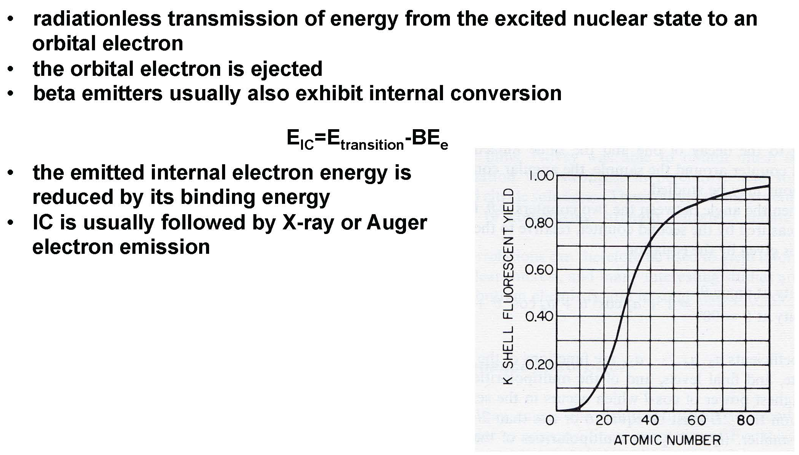
Internal Conversion
Notes:
Sometimes people confuse internal conversion with the Compton effect. There is no photon emitted from the nucleus that is absorbed by the electron. This is a radiationless transmission. Any photons you observe are from a follow-on process, like an electron filling in a lower energy vacancy.
Internal conversion can lead to X-ray (from electrons falling to fill in lower vacancies) or Auger electron emission (where the atom de-excites by “kicking out” an outer shell electron.

Slide 52
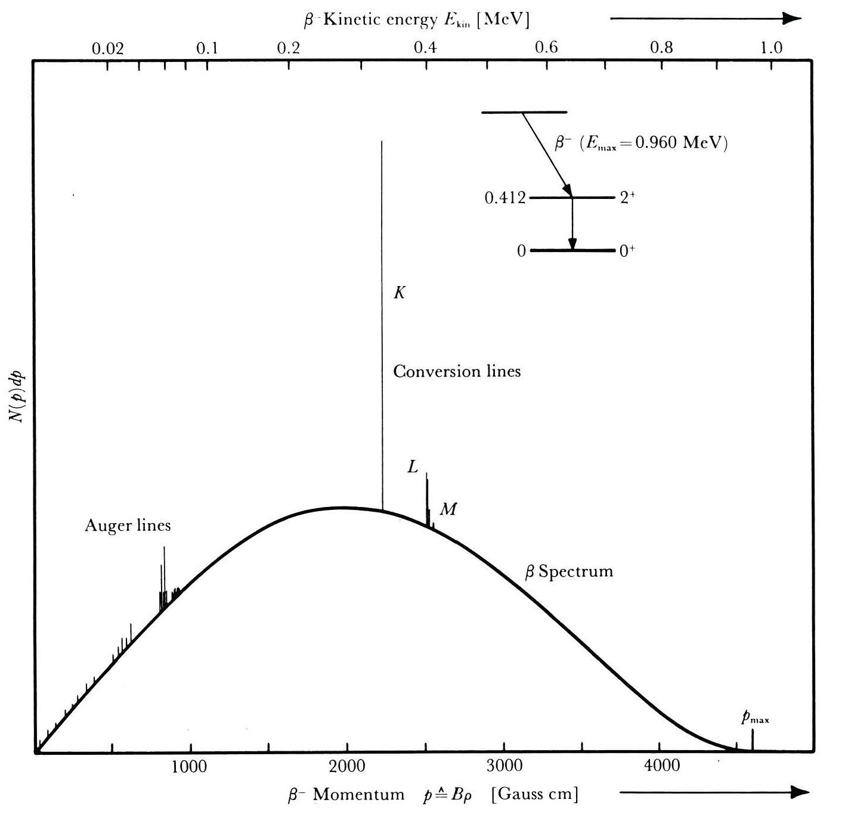
Signature of Internal Conversion in Beta Spectrum
Notes:
The broad, smooth curve is from the beta decays.
The large peak labeled “K” is from the K shell being filled by an L shell electron. (This “hole” or “vacancy” was from the electron that received the energy from the nucleus (in a radiationless manner) that then allowed the L-shell electron to fall into the K-shell vacancy.
Note the Auger lines, to the left, are from outer shell electrons that are liberated to de-excite the atom.

Slide 53
Production of Photons
Following beta-decay:
Emitted by excited nucleus as it transitions to a more energetically favorable (lower energy) state
Appears with the half-life of the parent but with energy that reflects the energy level structure of the daughter
Typically a very fast process (< picoseconds)
Equal to the difference in the energy levels
Mossbauer effect generally not an issue here
How can you estimate the time for photon emission from the excited nucleus?
Bremsstrahlung
Annihilation
Notes:
Fission products are neutron rich so they like to beta decay (change an n to a p) to become more stable.
Usually these daughter nuclei (from the beta decay) are in an excited state that emits a gamma ray which, since it is penetrating, we have a greater chance of detecting (as compared to detecting the beta electron).
Detecting the electrons from the beta decay in a “detection” problem would be difficult because of their short range and the ability to easily shield them with small amounts of material.
Note the equation above is slightly simplified. There is actually a small amount of energy given to the nucleus as recoil (you can use COM and COE to find it is equal to E²/(2*Mnucleus).
While the nuclear recoil is small, it still is enough to make sure that the photon is not reabsorbed by another nucleus (that is the same as the emitter).
How can you estimate the time for photon emission from an excited nucleus?
The Heisenberg uncertainty relationship.
What might cause “significant deviations” from the aforementioned estimate?
Differences in the nuclear spin from the parent to the daughter states.
What is Bremsstrahlung?
What is annihilation radiation?
If you have a positron decay (which we don’t see for excited decay products) you can get two 0.511 MeV photons when it thermalizes and annihilates with an electron

Slide 54
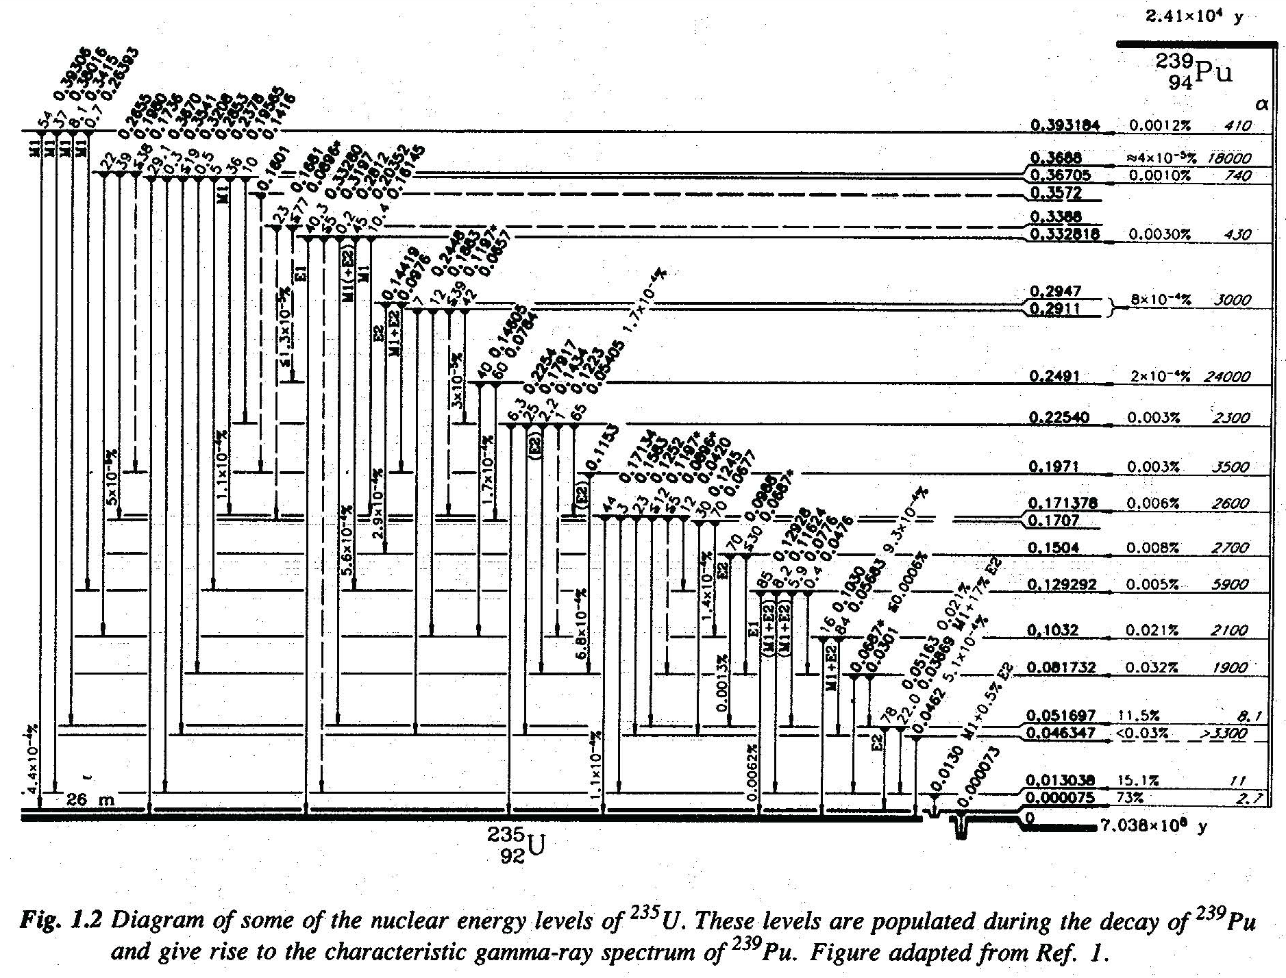
²³⁵U population from ²³⁹Pu Decay
Notes:
This is an ELD of the 235U nuclear levels. What is shown is population of these states from the alpha decay of 239Pu to 235U.
If you look at this, you see there are many, many closely lying states.
What type of decay takes you directly from 239Pu to 235U?
Alpha
Why are there so many closely lying states for some nuclei while for others the levels are well separated?
Collective behavior of the nucleus. Deformations of the nucleus. Etc.
How might the complexity of the parent and daughter excited states make isotope identification a much more difficult process?

Slide 55
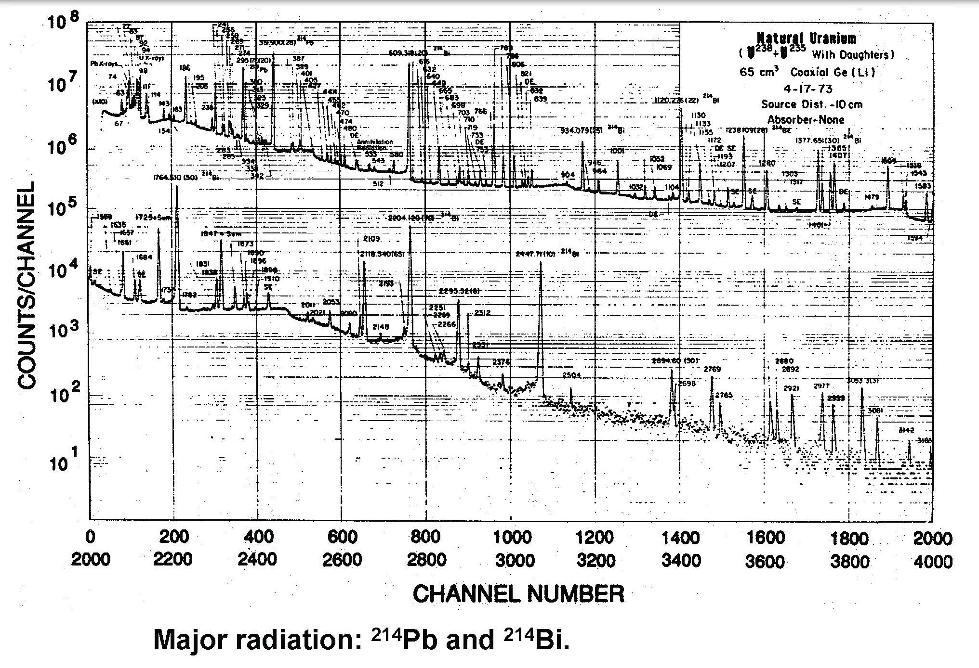
Photon Spectra from Uranium Ore
Notes:
As you can see, the spectra for uranium ore is very, very complex.
Obviously, due to the ability to resolve these many peaks, this was NOT taken with a scintillator. It was taken with a Ge(Li) detector.
We had to use a Ge(Li) detector to have good enough resolution (the ability to differentiate between lines) so we good see the peaks.
Using a detector with less resolution, such as a NaI(Tl) detector would not allow differentiation of all these peaks.

Slide 56
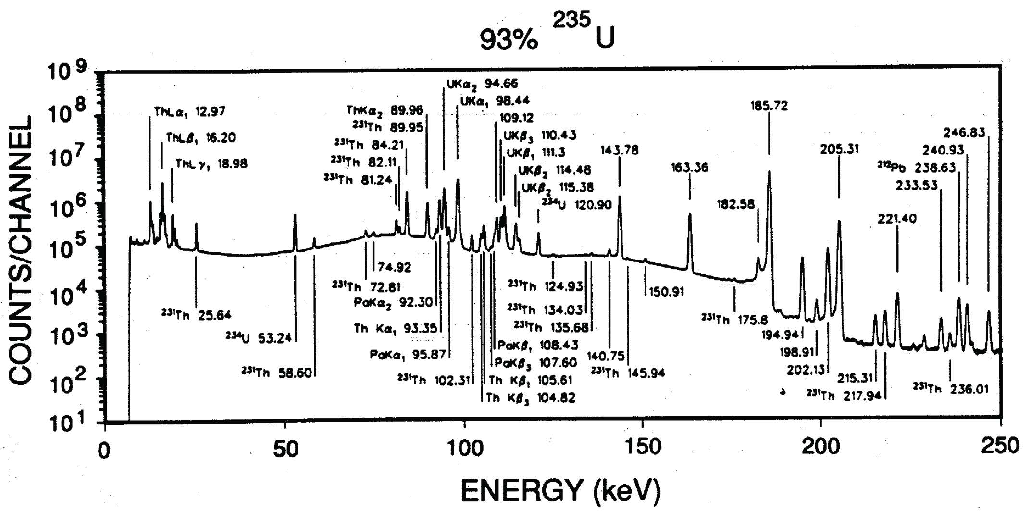
HEU Gamma Spectrum
Notes:
Here is an example of an HEU gamma spectra.
Since we can differentiate between these closely spaced peaks it must have been taken with a semiconductor detector, i.e. HPGe.
Why do we have all of these 231Th lines?
Alpha decay product from 235U
Note the presence of the strong 186 keV line from 235U.

Slide 57
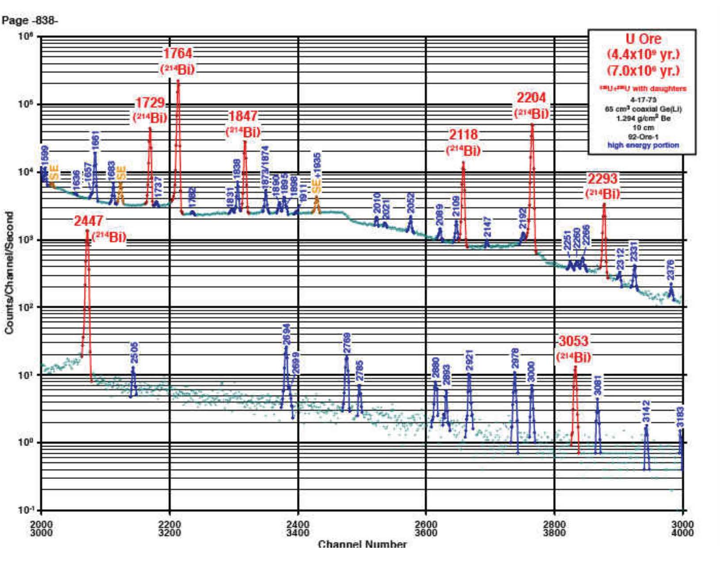
Uranium Ore Spectrum at Higher Energies
Notes:
At higher energies, there are also peaks that are present. With adequate separation, we could use a scintillator. However, this spectra is from a Ge(Li) detector.
Where do all the 214Bi decay lines come from?
214Bi is a decay product from 238U

Slide 58
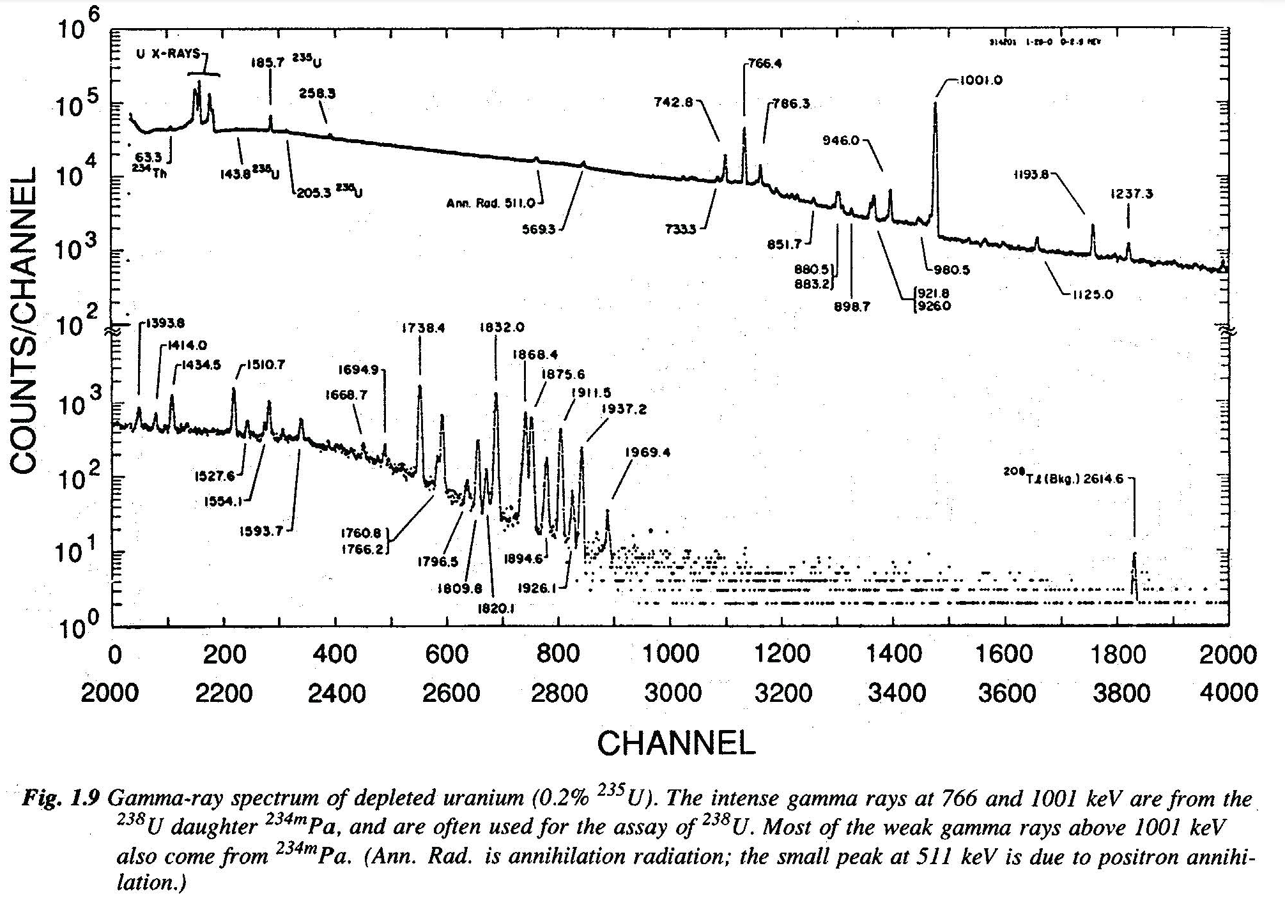
DU Spectrum (0.2% ²³⁵U)
Notes:
Note the greatly reduced 186 keV line (from 235U). It was very prominent in the HEU gamma spectrum (two slides back).

Slide 59
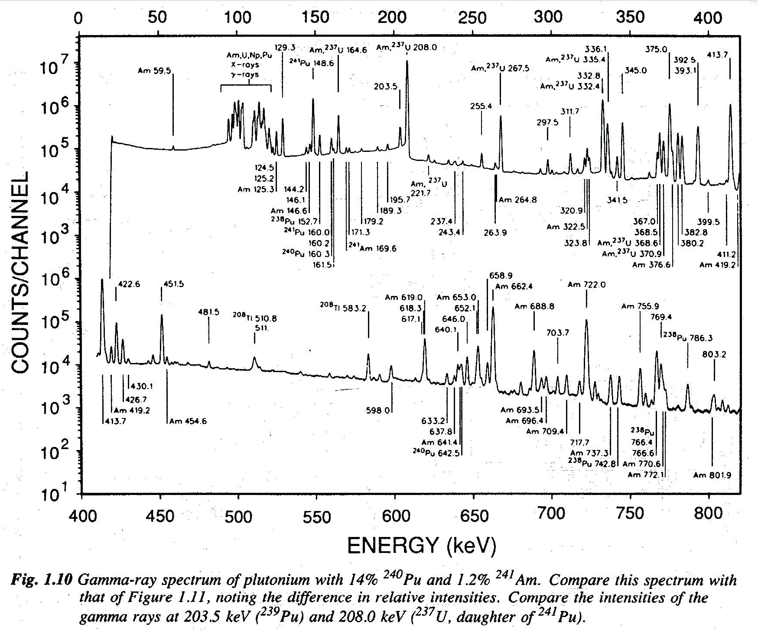
Pu Gamma Spectrum: 14% ²⁴⁰Pu, 1.2% ²⁴¹Am

Slide 60
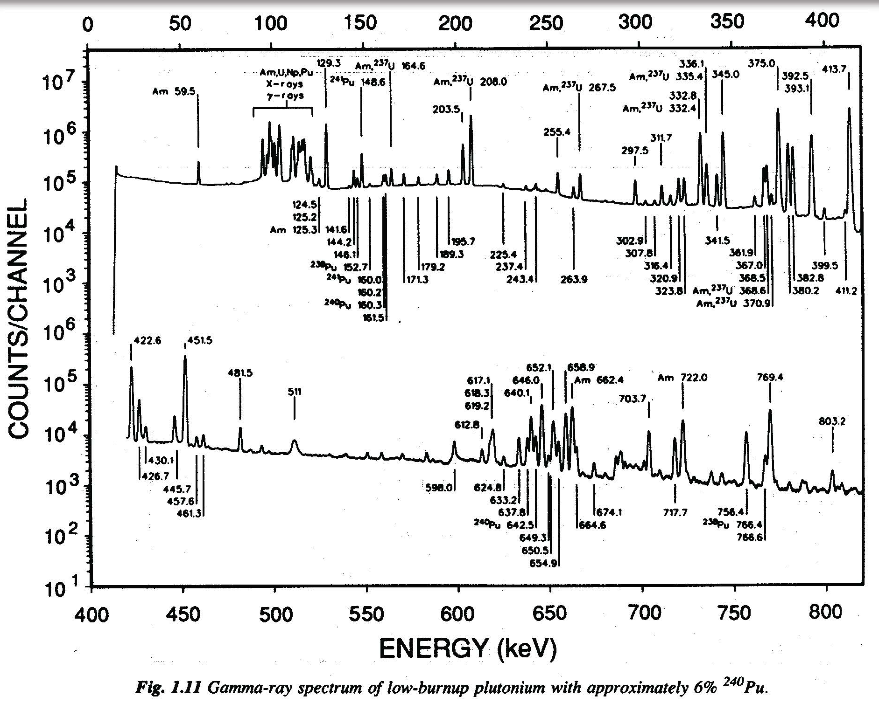
Pu Spectrum: 6% ²⁴⁰Pu

Slide 61
Why is HEU hard to detect?
Passive radiation from fissile material:
Neutrons
Plenty to measure from Pu
Too few to measure from HEU
Photons
Present and strongly penetrating from Pu
Plenty but weakly penetrating from HEU
In what way (a simplistic view) does background radiation “mask” weak signals from U but not Pu?
How does device design impact the ability to find and/or identify the presence of a weapon?
Notes:
This is a critical slide you should know and understand.
This is one of the most important questions of this class. And, as a DoD employee with nuclear expertise, it is one of the most important questions that you need to be able to answer.
When you think about the detection aspect of the proliferation problem, detecting the radiation from an HEU weapon is significantly more difficult than detecting a Pu-based weapon because of the signatures.
In what way (a simplistic view) does background radiation “mask” weak signals from U but not Pu?
Unlike plutonium, uranium is a ubiquitous presence in background radiation that can mask weak signals
How does device design impact the ability to find and/or identify the presence of a weapon?
Nuclear Weapons and components are relatively large, dense, and inhomogeneous—signal is highly dependent on device design
This combination of difficulties makes passive detection of HEU a task ranging from fairly straight-forward to impossible
In the end, the smaller signature from the U-weapon makes it much more difficult to detect than the Pu-based device.

Slide 62
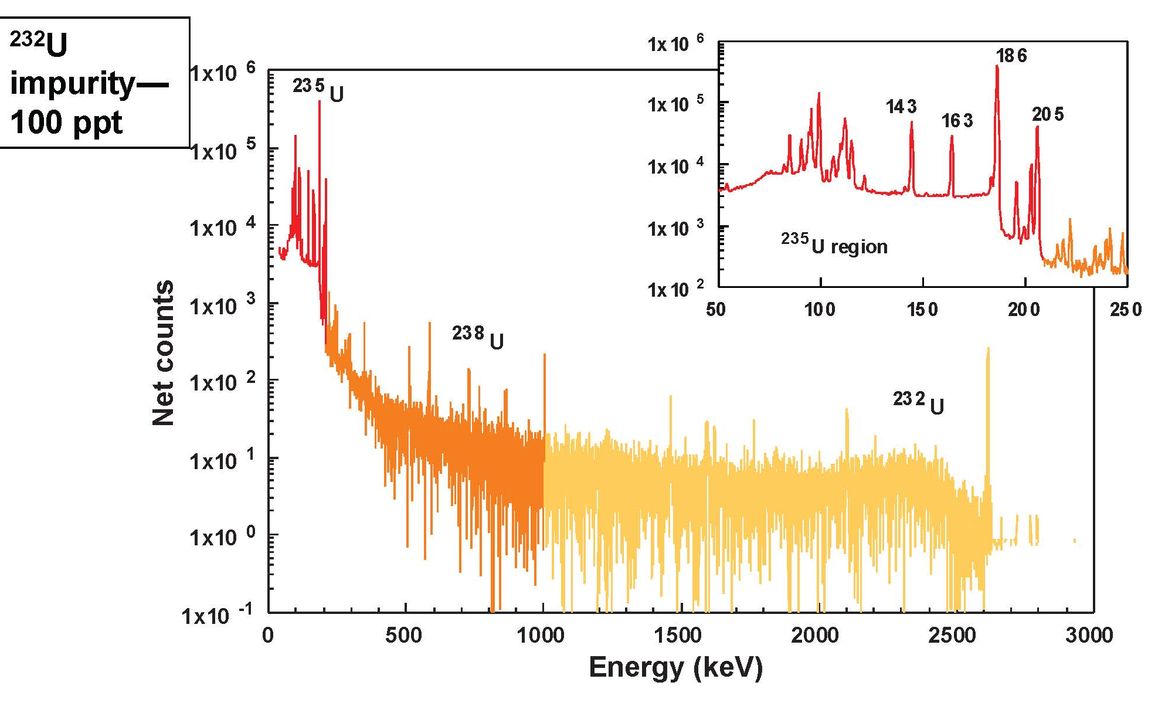
High-Quality, High-Resolution Spectrum of Reprocessed Fuel
Notes:
What does the presence of 232U say about the history of this material?
This fuel has been through a reactor.
Isotopes other than 238U, 235U, and (trace) 234U mean that at least a portion of this material has been through a reactor.
232U has 129.1 keV (6.5x10^9 gamma/gram-s), 270.5 keV (3.0x10^7) and 327.8 (2.7x10^7) gamma lines

Slide 63
Principal Gamma Lines Associate with HEU
186 keV (²³⁵U)
Most intense line emitted by ²³⁵U
Weakly penetrating
Identifies presence of ²³⁵U
By itself an insufficient indicator of the presence of HEU
1001 keV (^{234M}Pa granddaughter of ²³⁸U)
Most intense line associate with ²³⁸U
Strongly penetrating
Uniquely identifies the presence of ²³⁸U
By itself an insufficient indicator of the presence of HEU
2615 keV (²⁰⁸Tl decay descendent of ²³²U trace impurity)
Strongly penetrating
May infer the presence of HEU
Notes:
This slide is critical.
You should understand the significance of these lines and what is / is not detectable.
Why does the identification of the 186 keV or 1001 keV gamma lines not indicate the presence of HEU?
Uranium 235 and 238 are both present naturally in the background
Why does the presence of the 2614 keV gamma line not uniquely identify the presence of HEU?
208Tl is also part of a natural decay chain present in the environment.
Additional testing, and some math, may provide you better insights into what the material actually is.

Slide 64
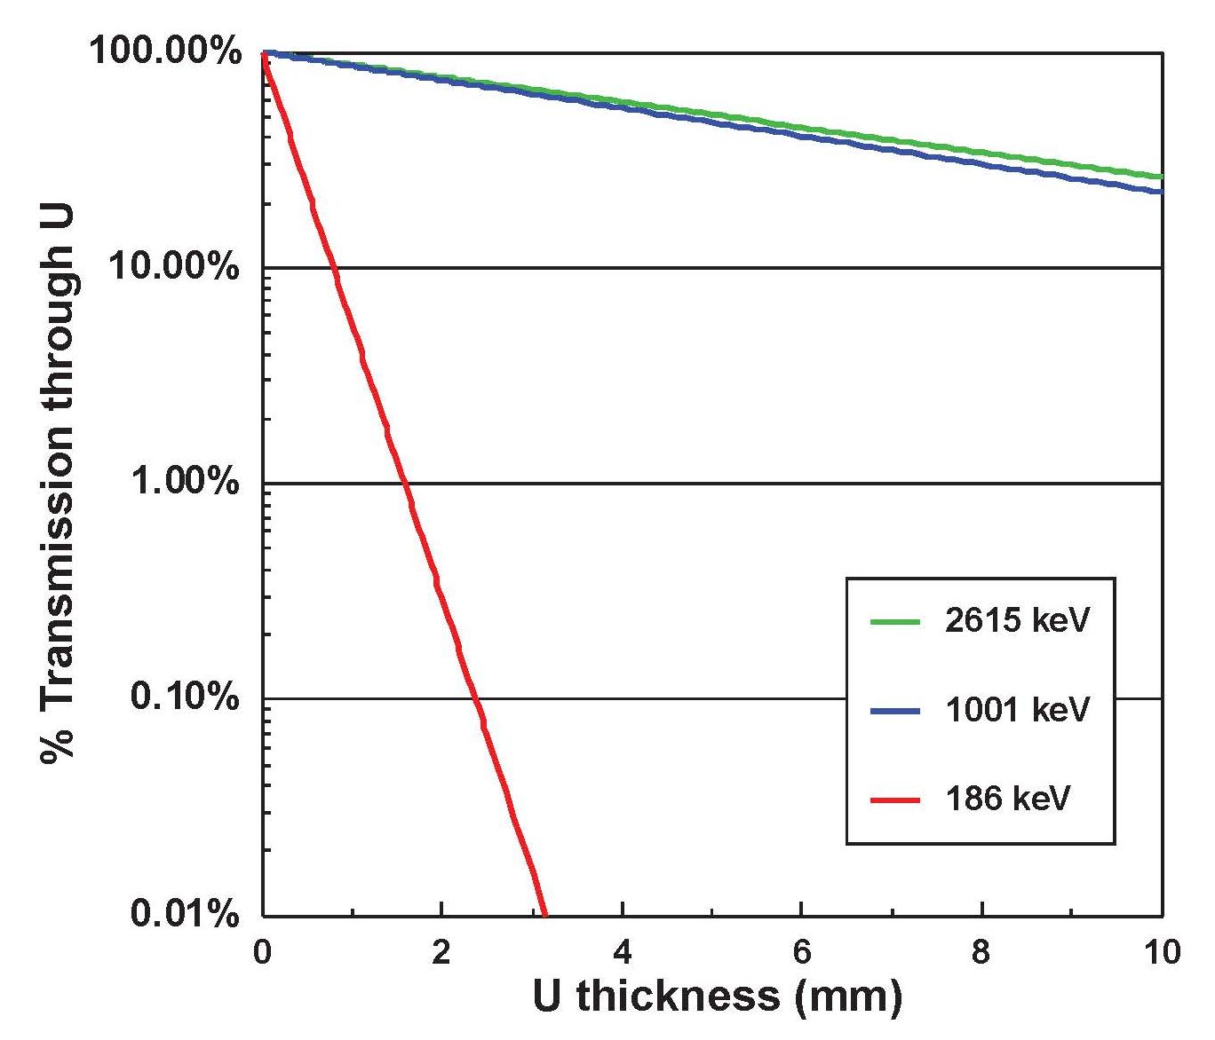
Why is the 186 keV line is not as useful as the 1001 keV line for detection?
Notes:
This slide here basically tells you that the 186 keV line is very, very easily shielded. 3 mm of U basically reduces the flux (not considering build up) by four orders of magnitude!
The point of this graphic is that a small amount of material makes detection of the 186 keV line extremely difficult.
Note that the 2615 and 1001 keV lines are not attenuated nearly as much so they are the gammas we would look for.

Slide 65
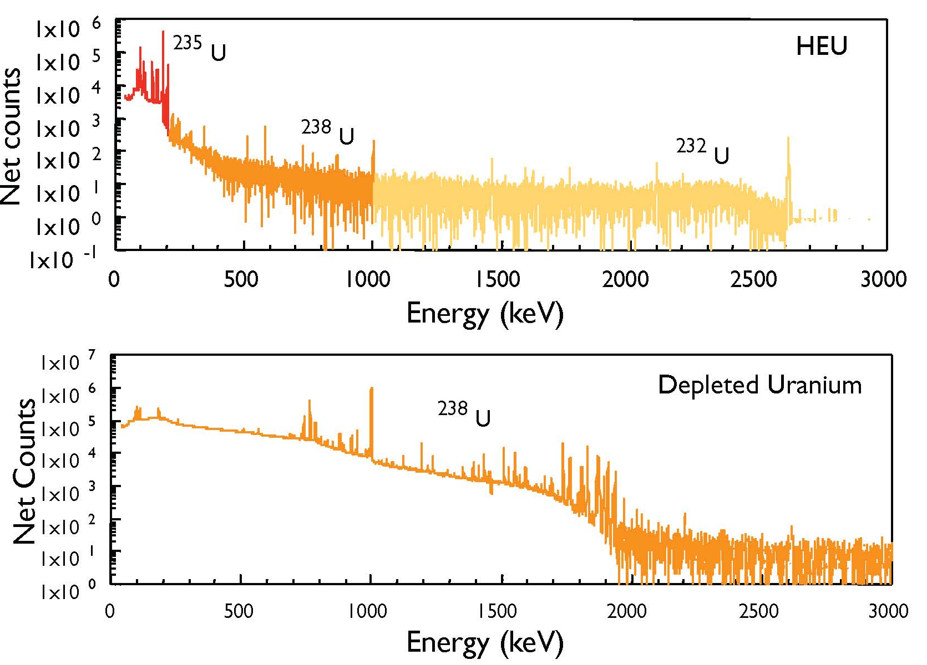
Is it HEU or DU or just natural U?
Notes:
For lightly shielded sources (means we don’t attenuate the 186 keV line away) the relative heights of the 186- and 1001-keV line counts (fluxes) can be used to indicate the presence of HEU.
Note the significance presence of the 235 line in the HEU spectrum but its notable “absence” (it’s still there. Just really small) in the DU line.
Here are two spectra, which show you the impact of the presence of the enriched 235U content. The 186 keV (for a lightly shielded source) is clearly visible.
It’s presence in spectra means that there is 235U present.

Slide 66
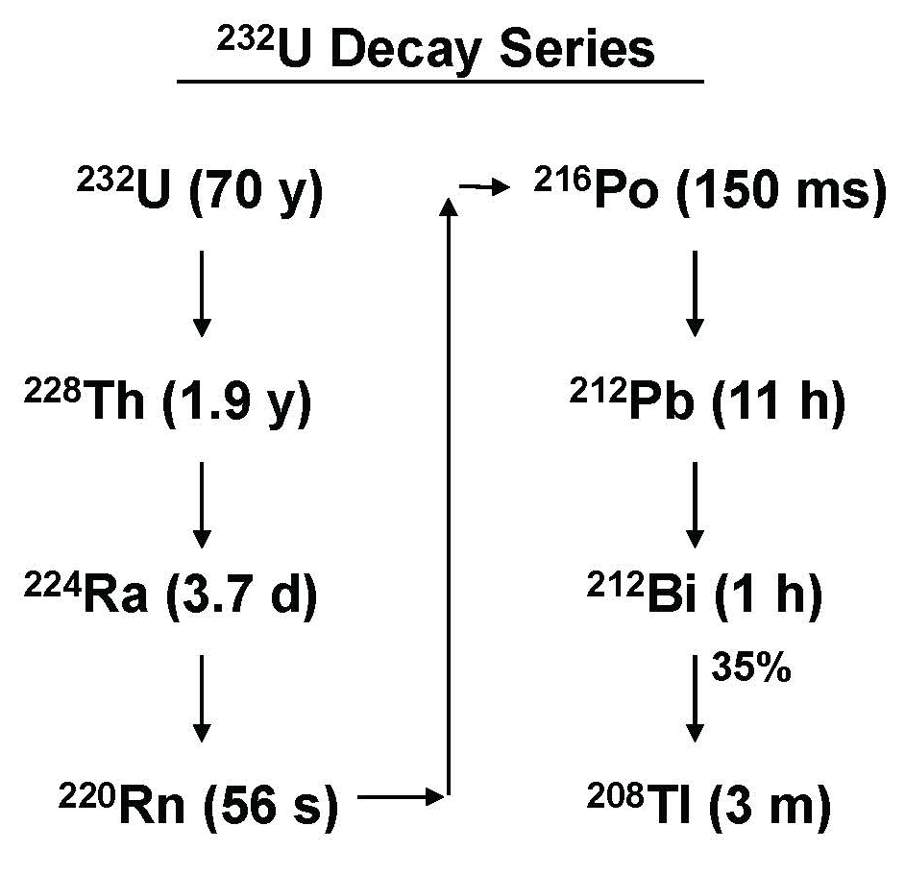
²³²U and the 2615-keV gamma
²³²U is not naturally occurring
It is produced in nuclear reactors
It appears as a contaminant in the U-isotope separation cascade due to reprocessing reactor fuel
It will appear preferentially in the low-mass fraction of the isotope separation
The 2615-keV gamma is emitted from ²⁰⁸Tl (descendent of ²³²U)
Background ²³²Th also decays to ²⁰⁸Tl, masking the ²³²U signal
Notes:
You need to understand that 232U is NOT naturally occurring. Thus, its presence indicates that what you are looking at has been through a reactor.
If you are doing forensics on a sample (say one captured or seized) its presence instantly tells you the material came from reprocessing.
Note that 232Th also decays to 208Tl so seeing the 2615 keV line could mean you have 232U present but it also may mean there is 232Th present (which is naturally occurring).

Slide 67
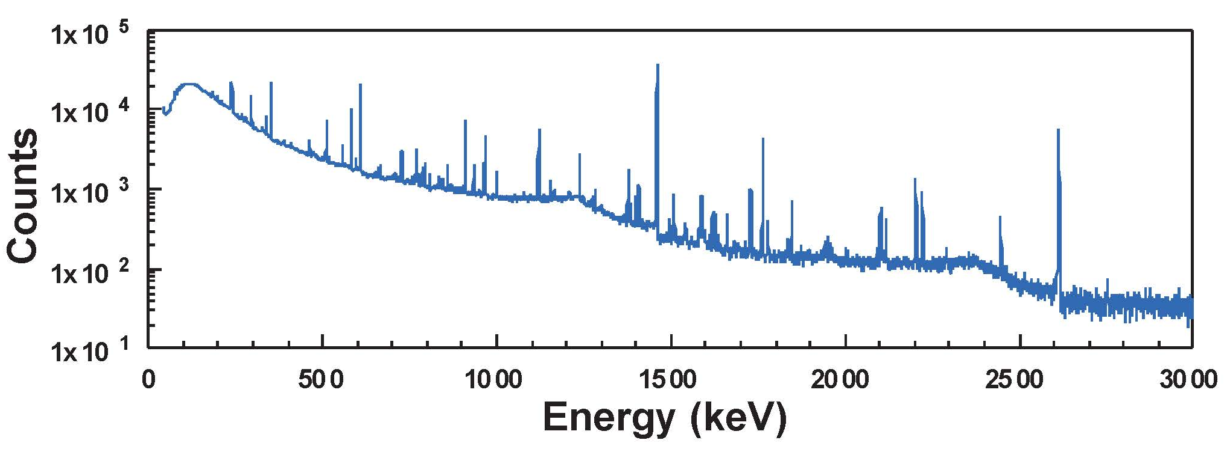
Potential use of 232U as an indicator of HEU
Use of ²³²U as an indicator of HEU may be feasible
We need greater knowledge of the amount (and variation) of ²³²U to the amount of ²³⁵U in the material being measured
This knowledge is known (or can be acquired) for US material
May be problematic for foreign material
Background ²⁰⁸Tl may obscure the signal from deeply embedded HEU
Notes:
If we have samples of foreign fuels we may be able to make a comparison.

Slide 68

Where does 232U come from?
Notes:
You should understand these processes. (No, you don’t have to memorize them)
(1) Starts with alpha decay of 235U
(2) Starting with trace 234U
(3) Starting with non-fissioning neutron capture in 235U
(4) Starting with nuclear reaction (n,2n) on 238U
In each path, we need neutron captures or an interaction with a neutron for the process to occur. Hence, its presence tells us that at least a portion of the sample has been through a reactor at some point.

Slide 69
Conclusions about passive detection of HEU
What does the presence of the 186-keV line tell you?
Does the absence of the 186-keV line tell you about 235U or HEU?
Does the ratio of the 186- and 1001-keV lines indicate the presence of HEU?
What does the presence of 232U tell you about the presence of HEU?
What does the absence of 232U tell you about the presence or absence of HEU?
So do we look at individual lines or the full spectrum?
Is passive detection always effective?
Notes:
This is a critical slide.
Can you explain the “why” behind each statement? That’s the level of knowledge you need.
What does the presence of the 186-keV line tell you?
The presence tells you that 235U is present but not necessarily HEU
Does the absence of the 186-keV line tell you about 235U or HEU?
The absence does not indicate the absence of these materials
Does the ratio of the 186- and 1001-keV lines indicate the presence of HEU?
Maybe…
What does the presence of 232U tell you about the presence of HEU?
If you’ve got 232U, it came from a reactor.
What does the absence of 232U tell you about the presence or absence of HEU?
It is not an indicator of the absence of HEU.
So do we look at individual lines or the full spectrum?
Ultimately, concentration on individual lines is self-defeating—to maximize signal to noise we must analyze the full spectrum.
Is passive detection always effective?
For passive detection of shielded materials, these approaches may not be effective in some cases.

Slide 70
A small statistical digression…
Problem: Find a source in a uniform background.
What is the best detector to use?
(1) A small detector with good resolution?
(2) A large detector with poor resolution?
Notes:
You will frequently be asked “which detector should I use?”
This digression helps you to better understand how to answer the question…

Slide 71

A small statistical digression…
Notes:
The background counts is equal to the resolution, times the background G, times the detector efficiency
The noise is related to the square root of the counts.
The signal is related to the detector efficiency times the number of signal counts N
The lowest detection limit will be set by the signal over the detected background fluctuation

Slide 72

A small statistical digression…
Notes:
So the ratio of the detection limits (first equation)
Now we can see the counts depends on the resolution and efficiency of each detector
Resolutions (at energy) are a product of the detector.
Efficiency is also set (for given conditions) for the detector.
So for a UNIFORM background, if we can get enough counts in our HPGe detector, the statistical argument is valid that resolution is key
But when do we actually have a uniform background?

Slide 73
Plutonium Detection
Plutonium is a prolific emitter of neutrons and gammas
²³⁹Pu ~3.3x10⁹ 414 keV gammas/s/kg
For ²³²U contamination of HEU at 100 ppt there are ~8x10⁴ 2615 MeV gammas/s/kg—that’s a 5 OOM difference
WGPu will emit ~5.2x10⁴ n/s/kg
Almost all (99.98% come from ^{238,240,242}Pu impurities
In practical cases, there are other high energy gammas. Where do they come from?
Notes:
Now we are transitioning to Pu detection, which is the other important area to consider.
From a detection standpoint, this is the easier problem because of the neutron and gamma signatures (which are very penetrating)
In practical cases, there are other high energy gammas
From the decay of prompt and delayed fission fragments
Alpha and beta decays
Radio-isotope impurities
Prompt and delayed neutron interactions in materials surrounding the source, such as capture (nth,gamma) and inelastic (n,n’) scattering

Slide 74

Some Useful Photons for Pu Identification
Notes:
Here are some key gamma lines for Pu identification

Slide 75

Summary of Major Gamma Signatures from SNM
Notes:
Key slide to understand.
From the MFP columns, you get an idea of how easy (or difficult it is) to shield the different photons.

Slide 76

Nuclear Resonance Fluorescence
Notes:
Don’t get caught up in the equations or the math. There is a very simple physics explanation for what is going on.
(1) You have a source of photons, either a narrow beam at the right energy or more practically a “broad” beam containing the right energy for excitation of the 235U
(2) When the photons pass through the 235U, they are at just the right energy to be absorbed (at least a fraction of them) forming a 235U* excited nucleus
(3) When the nucleus de-excites, it emits the photons isotropically.
(4) when you look at your spectra of what has been transmitted, you will see a “gap” at the resonant energy of the 235U.
There are other ways to do this but this is a very, very simple explanation.

Slide 77

NRF Cross Sections
Resonances are related to:
The width of the excited energy levels
Spin of the initial and final levels
Excitation energy
Broadening owing to the Doppler effect caused by thermal motion
Angular distribution of the resonant photons is determined by the spin of the initial and final states

Slide 78
Radiological Dispersal Devices
General Principles
Types of Materials
Effects
Radiation Threat
Weapons of Mass Disruption
Dispersion
Material Detection Issues

Slide 79
Potential Materials of Concern
Start with all isotopes: ~ 3715
Eliminate all non-radioactive materials: ~ 3031
Eliminate all radionuclides with half-lives of < 7 days or > 100,000 years or with specific activity < 0.01 Ci/g: 233
Eliminate radionuclides not commercially available: 104
Consider only materials commercially available in quantities sufficient to make an RDD: 14
> 0.1 Ci for alpha emitters
> 1 Ci for beta or gamma emitters
Include spent fuel

Slide 80

RDD Materials

Slide 81

Decay Series

Slide 82

Spontaneous Fission
Z²/A > 45 for SF
Prompt gammas and neutrons emitted within 100 fs of scission
Fission fragments carry most of the energy (~170 MeV)
Due to barrier penetration, fission rate is very sensitive to Z and A
Usually the SF rate is much smaller than the alpha decay rate

Slide 83

SF Neutron Yields

Slide 84
Spontaneous Fission Rates
SF rate OOM: OO~1, OE/EO~10³, EE~10⁵
Reasoning behind the differences: Nuclear Spin effects
Total nuclear spin must be conserved during deformation
Outermost protons and neutrons shift from the ground state to the excited state
(e,e) have ground state spin zero and can simultaneously couple their spin to zero while shifting to the ground state
(o,x) single neutron or proton must occupy the orbit that conserves the total nuclear spin even though extra energy is required
Thus, fission barrier is raised for (o,x) nuclei

Slide 85

Common Spontaneous Fission Sources

Slide 86


Slide 87


Slide 88
Detection of Fast or Thermal Neutrons?
A neutron source cannot be easily detected unless some moderator is present
Scattering and attenuation of thermal neutrons by air or other intervening materials must be accounted for
Thermal neutrons are generally less abundant than fast neutrons but can be detected with greater efficiency
Easy to stop thermal neutrons so lightweight directional detectors are possible
Majority of “background” neutrons are fast so moderator free detection systems should have lower background counts
New directional fast neutron detectors are being developed

Slide 89
Neutron Induced Delayed Gammas
Gammas can penetrate cargo and hence can be detected externally
Little spectral information so we need good energy resolution detectors
Use neutrons below 10 MeV to eliminate gammas from the ¹⁶O(n,p)¹⁶N reaction

Slide 90

Delayed Gamma Energy Spectrum

Slide 91


Slide 92


Slide 93


